Slide 1
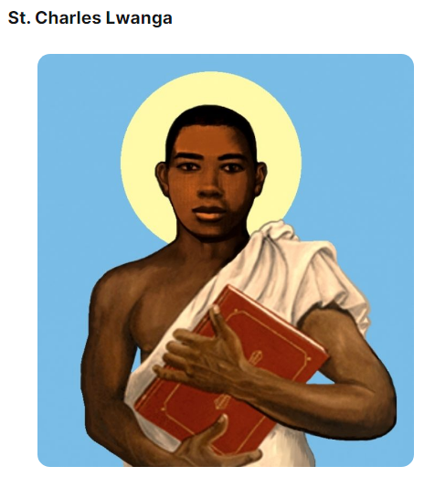

St. Charles Lwanga is a martyr and saint. He is one of 22 Ugandan martyrs. He defended his young adult companions against the demands of the Bugandan king, and instructed them in their Catholic faith.
He is the patron saint of African Catholic Youth Action, converts, and torture victims.
The Church celebrates his feast on June 3.
Prayer for the intercession of St. Charles Lwanga:
“Martyrs of Uganda, pray for the faith where it is in danger and for Christians who must suffer because of their faith. Give them the same courage, zeal, and joy you showed, and help those of us who live in places where Christianity is accepted to remain aware of the persecution in other parts of the world.
Amen.”

Slide 2
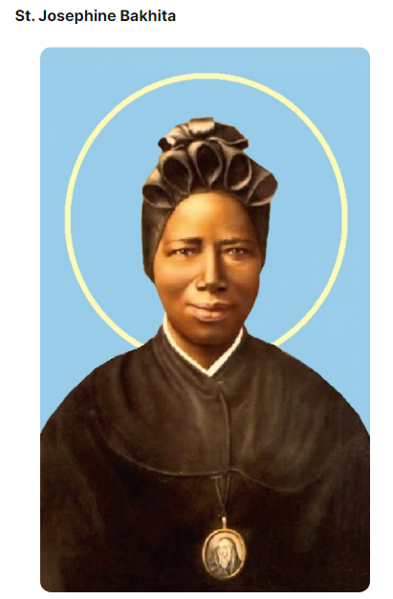

St. Josephine Bakhita was kidnapped and sold as a slave in Sudan at age 7. Her owner brought her to Italy, where she became a babysitter. She eventually felt drawn to the Catholic Church.
Her owners wanted to take her back to Sudan, but she refused. Slavery was actually illegal in Italy, so a court ruled her free. She later joined the Institute of St. Magdalene of Canossa religious community.
She is the patron saint of Sudan and human trafficking survivors.
Prayer for the intercession of St. Josephine Bakhita:
St. Josephine Bakhita, you were sold into slavery as a child and endured untold hardship and suffering. Once liberated from your physical enslavement, you found true redemption in your encounter with Christ and his Church.
O St. Bakhita, assist all those who are trapped in a state of slavery. Intercede with God on their behalf so that they will be released from their chains of captivity.
Those whom humanity enslaves, let God set free. Provide comfort to survivors of slavery and let them look to you as an example of hope and faith.
Help all survivors find healing from their wounds. We ask for your prayers and intercessions for those enslaved among us.
Amen.

Slide 3
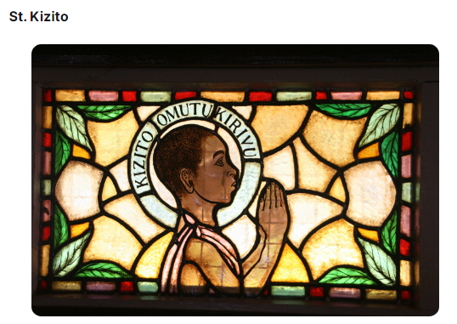
St. Kizito was the youngest of the 22 Ugandan martyrs.
King Mwanga II of Buganda burned him to death at age 13 after learning he was Christian. As he was burned alive, he recited the ‘Our Father.’ His last words were, ‘Goodbye my friends, we are on the right path.”
St. Kizito’s feast day is June 3. He is the patron saint of children and primary schools.
Prayer for St. Kizito’s intercession:
O Glorious Kizito, obtain for us, from our Lord, peace and unity, victor in temptation, comfort in sorrow, strength in adversity, health in weakness and the grace which we earnestly pray for now:
(mention your private intention).
May we one day, enjoy with you, the imperishable glory of heaven. Through Christ Our Lord. Amen.
Our Lady Queen of Martyrs – pray for us!
O Martyrs of Uganda – pray for us!
St. Kizito – pray for us!

Slide 4
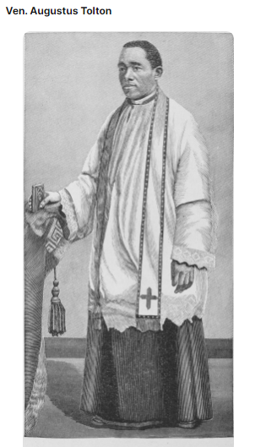
While not yet canonized, Venerable Augustus Tolton is on the path towards sainthood. He was the first-known black Catholic priest in the United States after his 1886 ordination.
Born into slavery and baptized Catholic in the United States, Venerable Tolton studied for the priesthood and was ordained in Rome. He was later sent to the United States to administer to the black community.
Prayer of Venerable Augustus Tolton:
Father in Heaven, Fr. Tolton’s suffering service sheds light upon our sorrows; we see them through the prism of your Son’s passion and death.
Complete what you have begun in us, that we might work for the fulfilment of your kingdom.
Not to us the glory, but glory to you O God, through Jesus Christ, your Son and our Lord; Father, Son and Holy Spirit, you are our God, living and reigning forever and ever.
Amen.

Slide 5
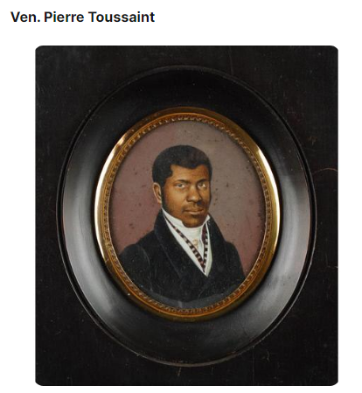
Ven. Pierre Toussaint was a salve whose owners moved to New York. He was educated and made his own money as a hairdresser, even caring for his owners when they could not care for themselves. His owner freed him after she died in 1807.
Pierre attended Mass daily and was devoted to the Rosary. He and his wife, (whom he freed with his own money) cared for orphaned and needy children. They also adopted a daughter who died at age 14.
Pierre died in 1853. St. Patrick’s Cathedral holds his remains in a crypt, where only archbishops and cardinals are buried.
St. John Paul II declared him venerable in 1996.

Slide 6


