Slide 1


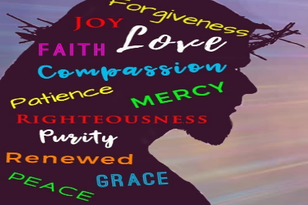
https://www.youtube.com/watch?v=Fi-zd2k8wgQ

Slide 2

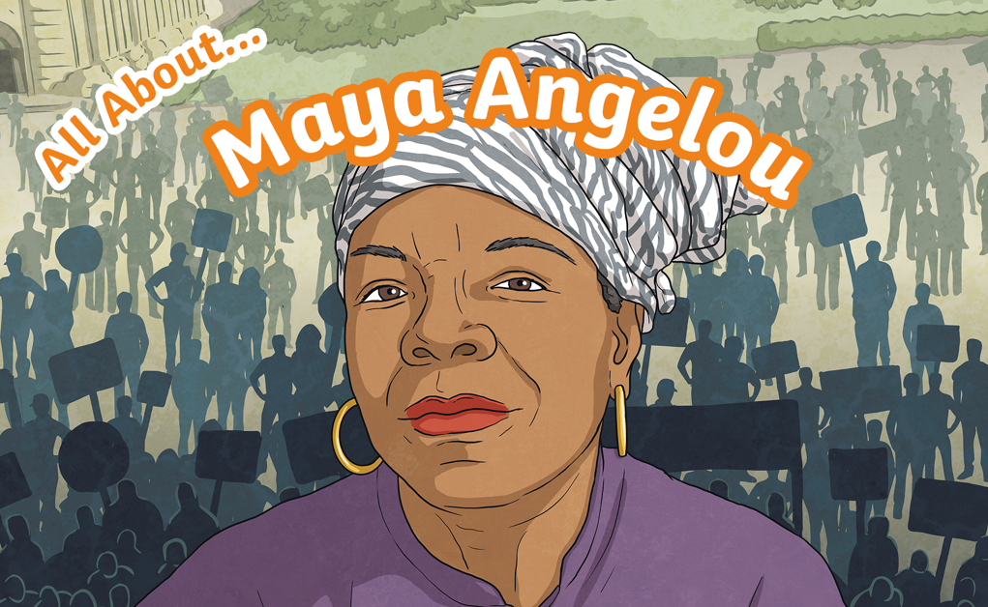
Black History

Slide 3

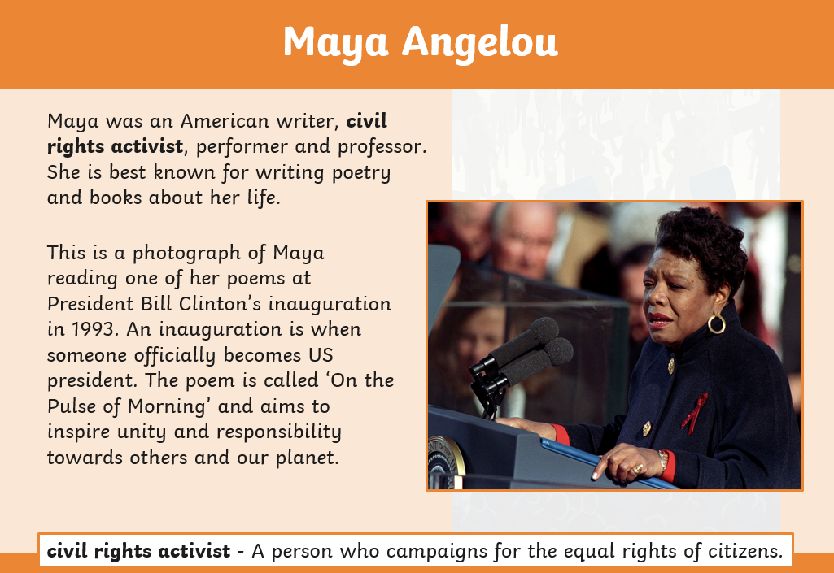

Slide 4
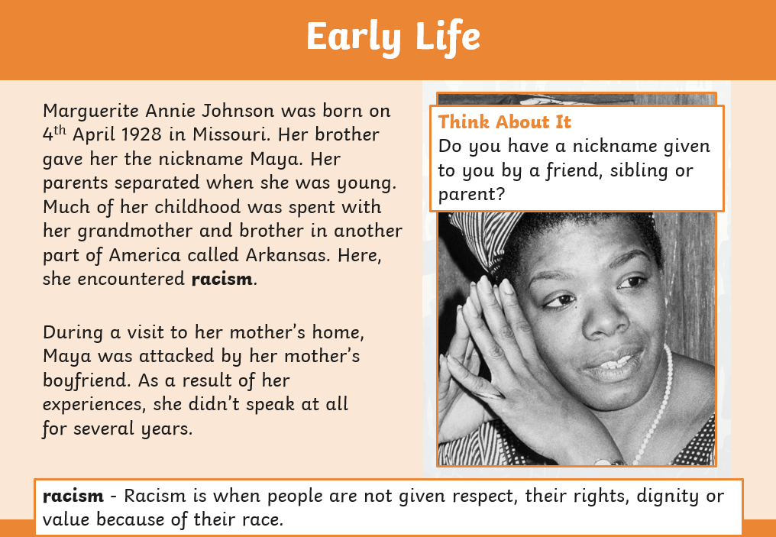

Slide 5
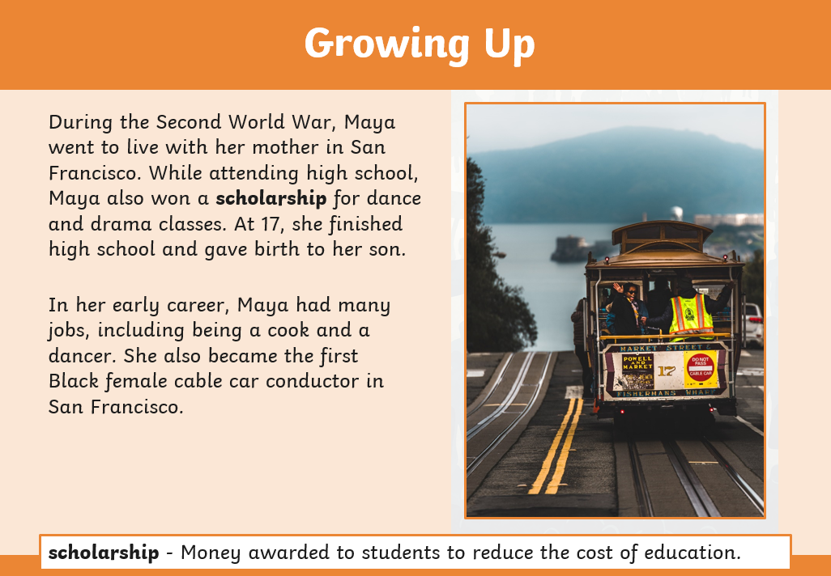

Slide 6
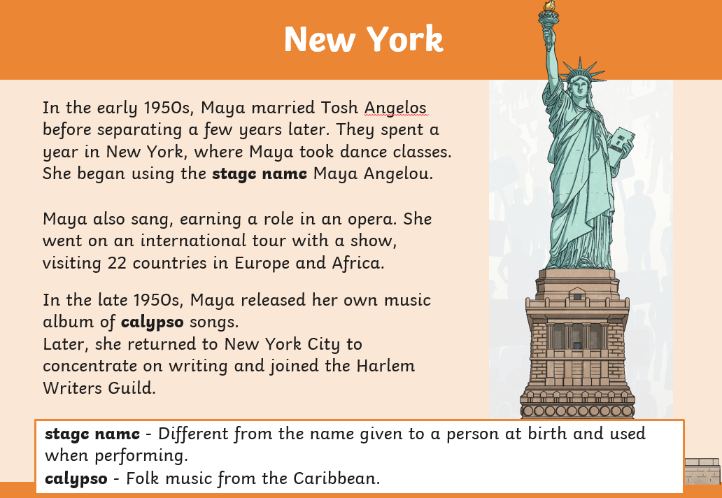

Slide 7
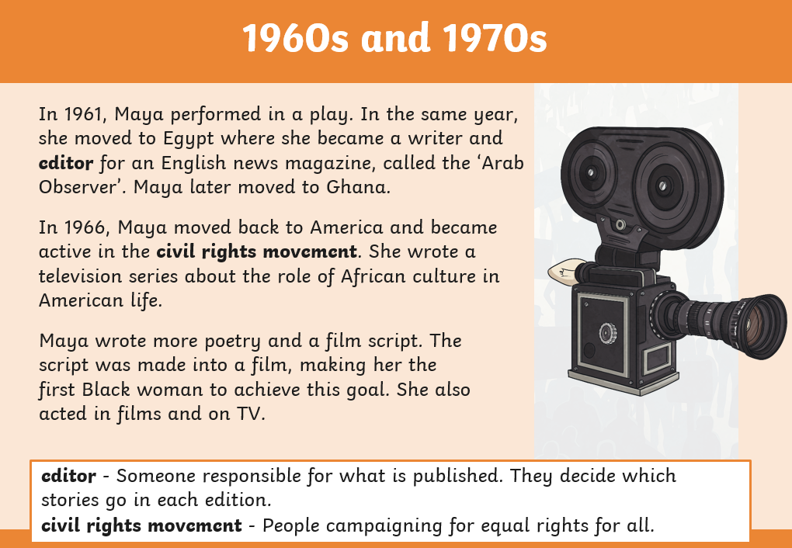

Slide 8


Slide 9
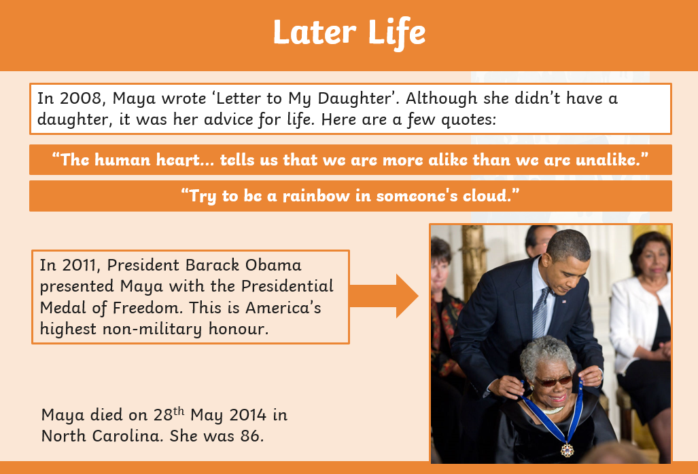

Slide 10
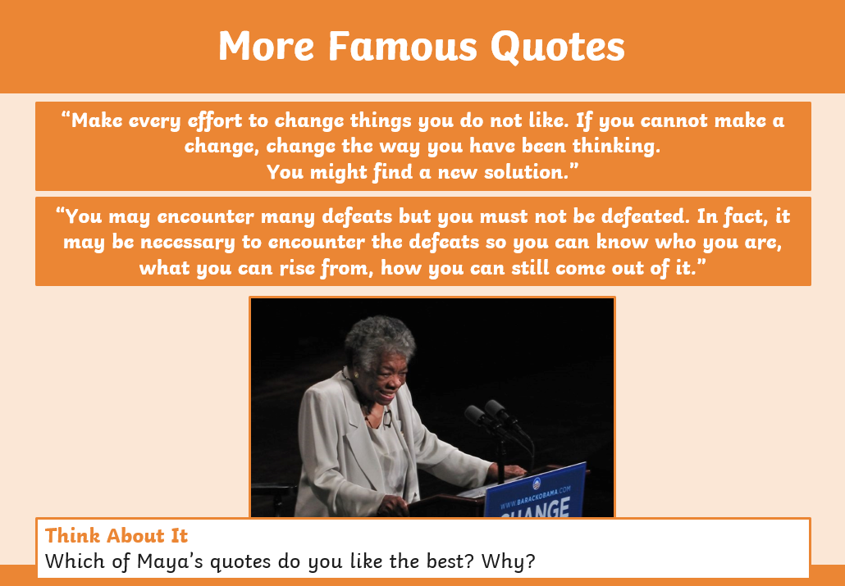

Slide 11
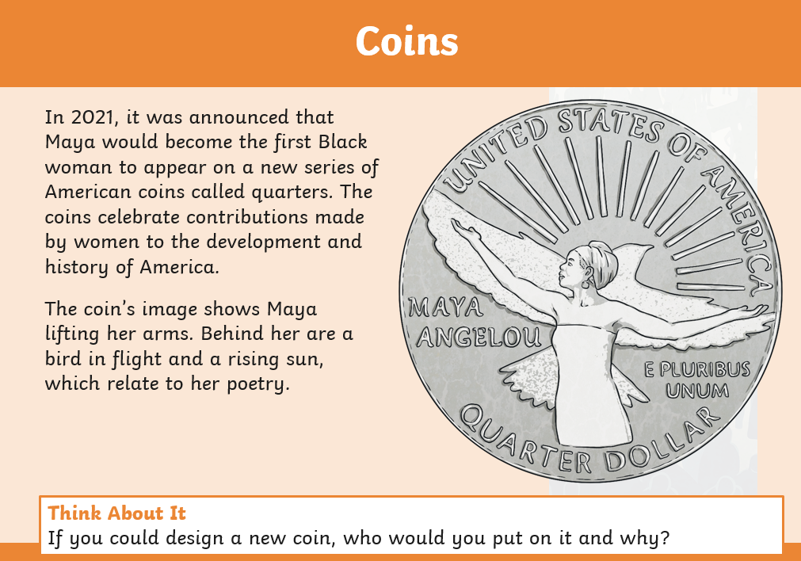

Slide 12
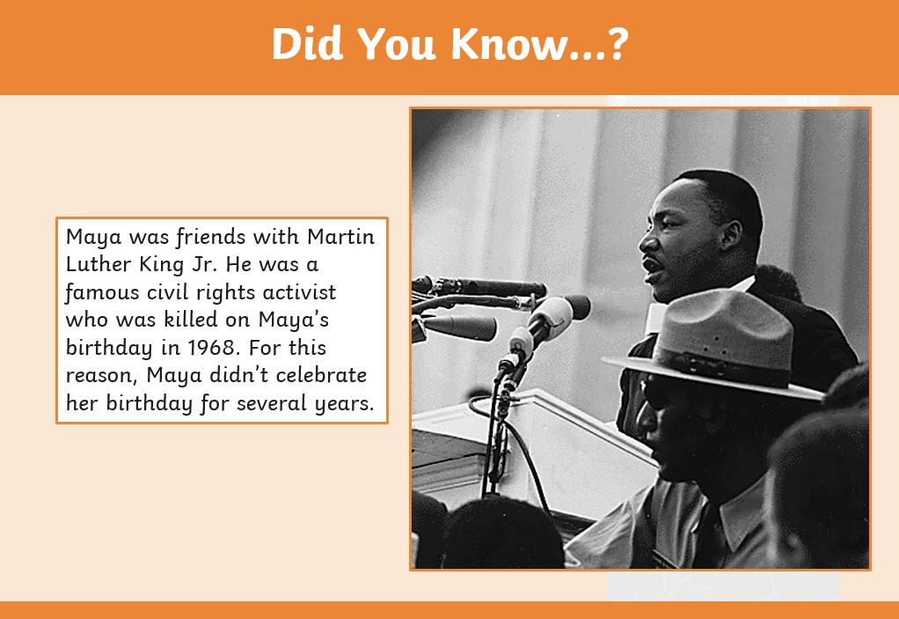

Slide 13
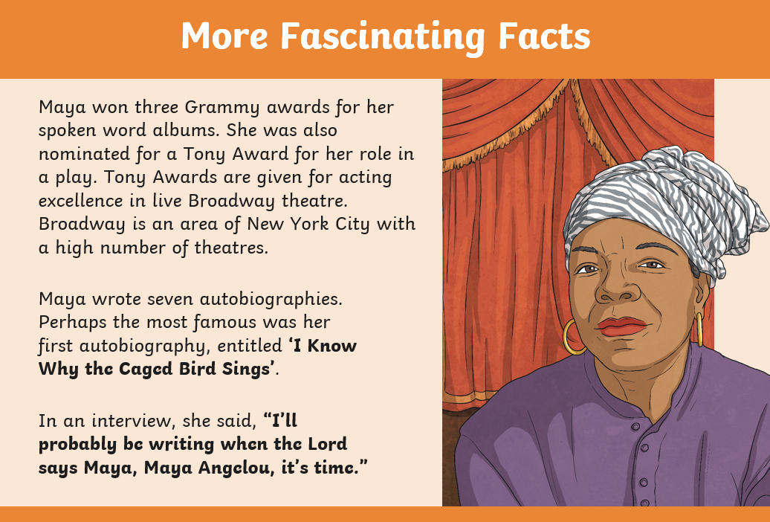

Slide 14
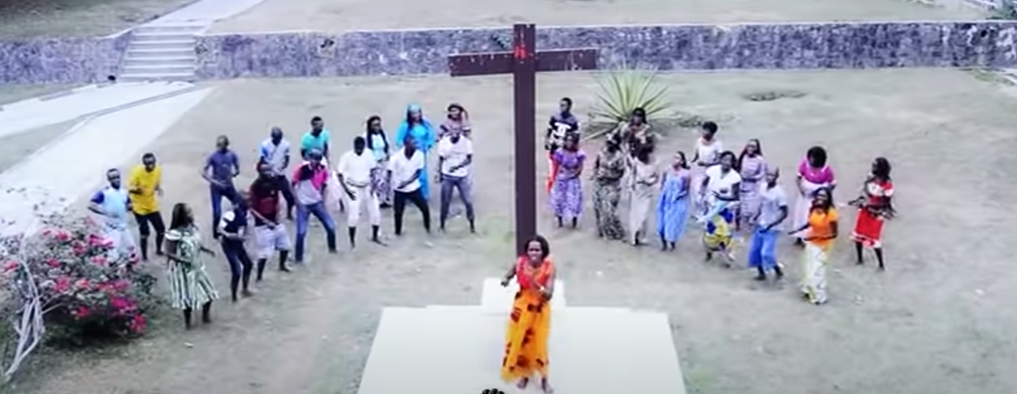
Siyahamb’ ekukhanyeni kwenkos
We are marching in the light of truth.
https://www.youtube.com/watch?v=Fi-zd2k8wgQ

Slide 15
“The human heart tells us that we are more alike than we are unalike!”

Slide 16
“Try to be a rainbow in someone’s cloud!”

