Slide 1





Student Finance 2019
Steph Strange– Student Engagement & Recruitment Manager

Slide 2


SESSION CONTENTS
Section 1 – The Student Finance Package
Section 2 – Student Loan Repayments
Section 3 – Applications & Information

Slide 3

THE STUDENT FINANCE PACKAGE
SUPPORT AVAILABLE TO STUDENTS INCLUDES:
Tuition Fee Loan
The
Student Finance
Package
Maintenance (Living Cost) Support
Bursaries & Scholarships
Additional Support

Slide 4

TUITION FEES & LOANS
Universities and colleges can charge new full-time students up to
£9,250 per year (£7,000 part-time) for tuition fees
Eligible students won’t have to pay any tuition fees up front
Tuition Fee Loan doesn’t depend on household income
SLC pay any Tuition Fee Loan directly to your university or college
The loan is repayable, but only when your income is over £25,000

Slide 5
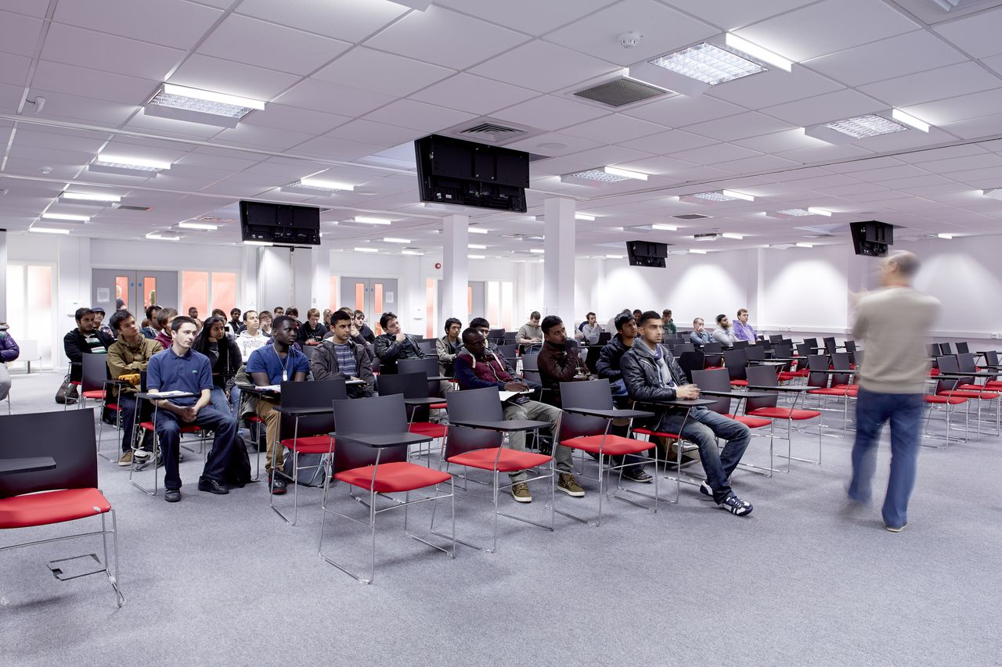
MAINTENANCE SUPPORT
Maintenance support is available to help with your living costs while
in higher education
The Maintenance Loan is repayable and all eligible students are
entitled to receive some funding
The amount of loan available will depend on where you live and study
Maintenance support is paid directly into your bank account each term

Slide 6

MAINTENANCE LOAN
2019/20 MAXIMUM RATES
Where you Live & Study | Maximum Loan Available
Parental Home Live at home | £7,529
Elsewhere Live away from home and study outside of London | £8,944
London Live away from home and study in London | £11,672
Overseas Study overseas as part of a UK course | £10,242
Additional loan is available for each extra week of study for
students attending their course beyond 30 weeks

Slide 7

BURSARIES & SCHOLARSHIPS
Many universities and colleges offer financial support to their students
through bursaries and scholarships
Bursaries:
Linked to personal circumstances and often, household income
Awards can include fee waivers or cash
Scholarships:
Can be linked to academic results or outstanding ability in an area
such as sport, music or art
Can be subject specific and are limited in numbers
Check university websites and ask at open days for information
on bursaries & scholarships

Slide 8
EXTRA SUPPORT
Other financial help and support may also be available if you:
have children or an adult dependent on you
have a disability, including a long-term health condition, mental-health condition or specific learning difficulty
Notes:
Childcare Grant
Helps with childcare costs for dependent children aged under 15 at the beginning of the academic year (or under
17 if they have special educational needs) in registered or approved childcare. For more details on what childcare
qualifies, visit www.gov.uk/studentfinance
Parents’ Learning Allowance
This allowance can help with course-related costs for students with dependent children.
Adult Dependants’ Grant
The grant can help if a student has an adult who depends on them financially. This can’t be the student’s grown-up child or other adult who gets student finance.
Disabled Students’ Allowances (DSAs) help pay for extra costs a student might have as a direct result of their disability, including a long-term health condition, mental-health condition or specific learning difficulty, such as dyslexia or dyspraxia. DSAs are additional support available to students who may otherwise be prevented from attending university or college because of their disability.

Slide 9

University of Bedfordshire
Scholarships/ Bursaries
// £1500 Bursary – all full time undergraduate students
// £2400 Scholarship for students achieving 112+ UCAS points in their Level 3 studies
// Sports Scholarships
// Foundation Year Bursary - £500
// £1500 Bursary – ALL full time undergraduate students
// £2400 Scholarship for students achieving 112+ UCAS points in their Level 3 studies
// Sports Scholarships
// Courses with Foundation Bursary - £2000 – for duration of 4 year programme

Slide 10




Slide 11

STUDENT LOAN REPAYMENTS
AN OVERVIEW
You won’t make repayments until your income is over £25,000 a year gross (before tax)
Full-time students will be due to start repaying in the April after graduating from/leaving their higher education course
You’ll repay 9% of your income over £25,000 and if you’re employed deductions will be made from your pay through the HMRC tax system
If your income falls to £25,000 or below your repayments will stop
Any outstanding loan balance will be written off 30 years after entering repayment

Slide 12

STUDENT LOAN REPAYMENTS
THE FIGURES
Income each year before tax | Income from which 9% is deducted | Monthly Repayment (Approx)
£25,000 | £0 | £0
£27,000 | £2,000 | £15
£30,000 | £5,000 | £37.50
£35,000 | £10,000 | £75
£40,000 | £15,000 | £112.50
£45,000 | £20,000 | £150
£50,000 | £25,000 | £187.50
£60,000 | £35,000 | £262.50

Slide 13

STUDENT FINANCE APPLICATIONS
KEY MESSAGES –GET IT RIGHT FIRST TIME
Apply online at www.gov.uk/studentfinance as soon as possible to make
sure your student finance is in place for the start of your course
Register on UCAS and we can let you know when it’s time to apply
You don’t need a confirmed place at university or college to apply
for student finance
Make a note of your account log-in details & keep them safe
You can change your details online before starting your course
Agree to share information from your application, this helps apply
for many bursaries and some scholarships

Slide 14
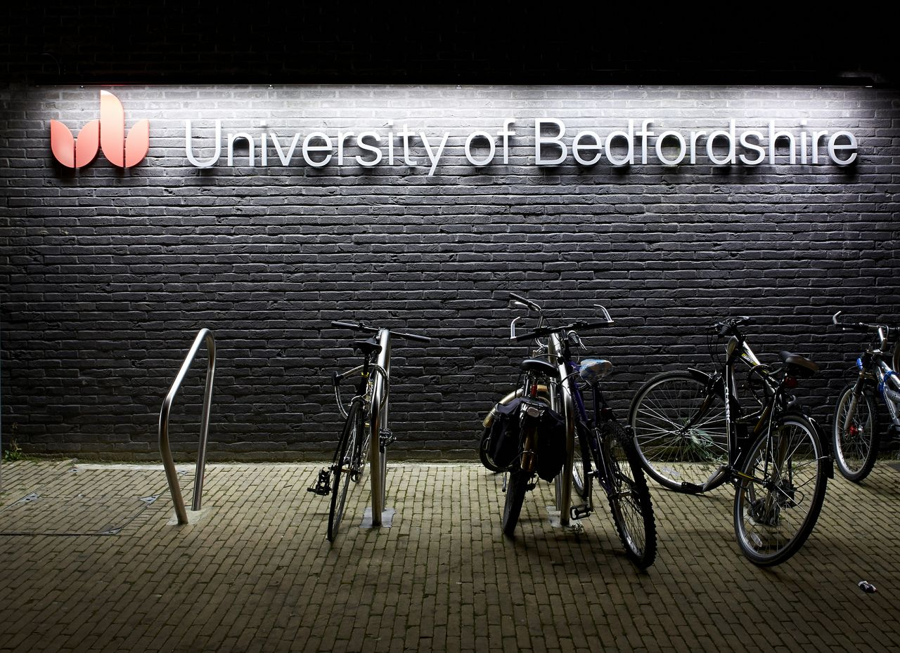
STUDENT FINANCE APPLICATIONS
INFORMATION YOU WILL NEED TO PROVIDE
Before starting the application, you should have the following to hand:
• Passport - SLC can check identity using valid UK passport details
for most students
• University and course details – You can share this information online, directly from you UCAS application
• Bank account details
• National Insurance number
• Parent’s or partner’s National Insurance number and income details
For most applications, SLC verify income from these NI numbers
with no need to send any documents, unless we ask for them

Slide 15

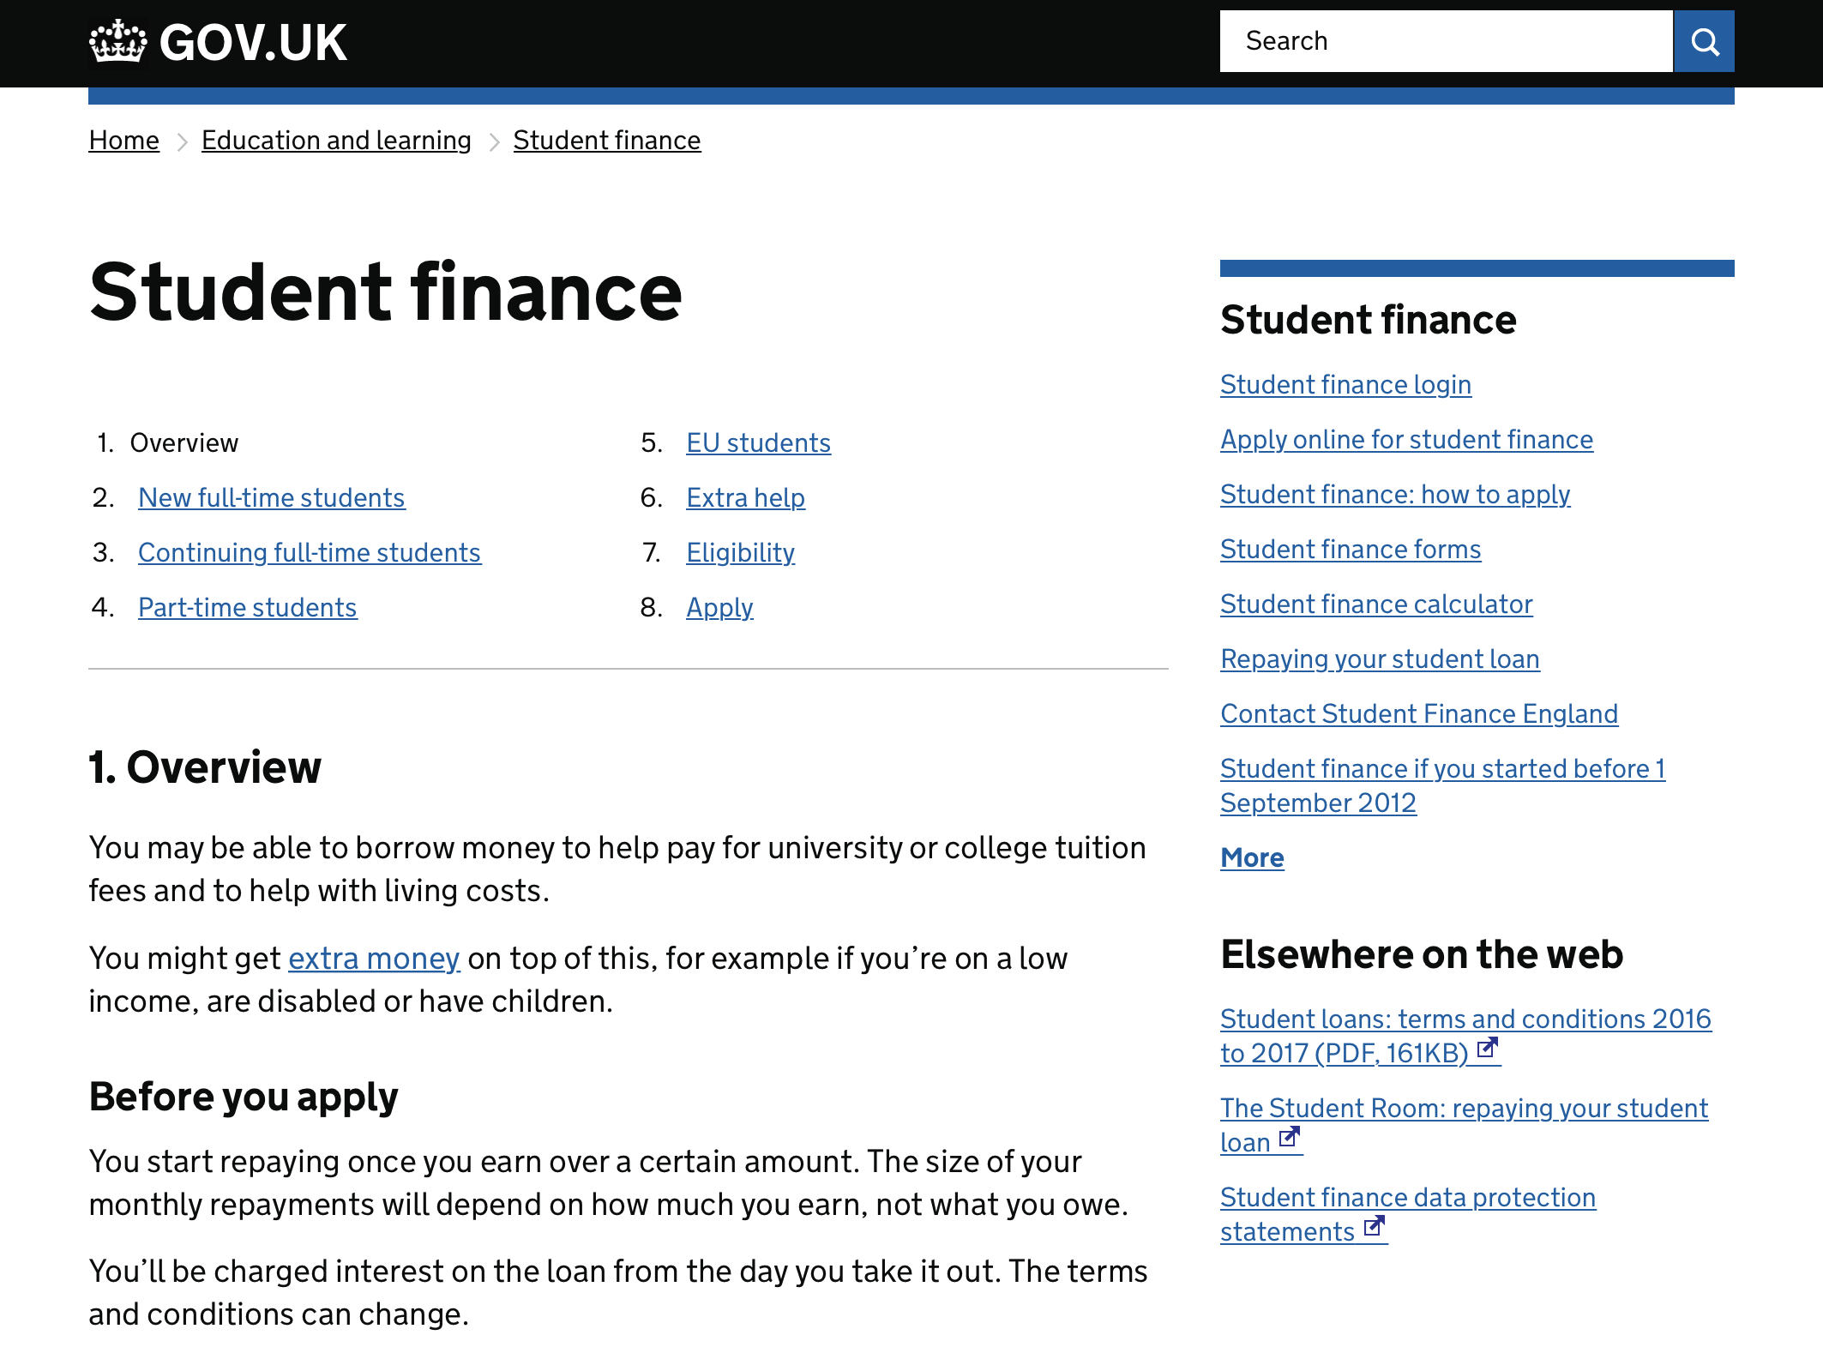
GOV.UK
FOR MORE INFORMATION & TO APPLY

Slide 16

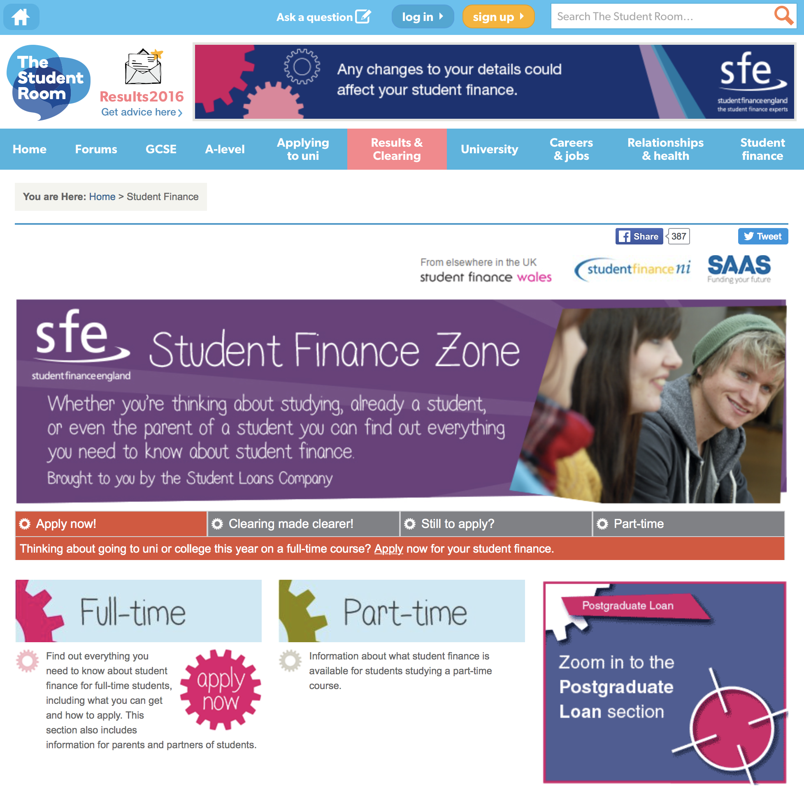
THE STUDENT ROOM
FOR FURTHER INFORMATION & RESOURCES

Slide 17


HOW MUCH?
BOOKS & RESOURCES
?
How much does this textbook cost?
£37.79 New
£9.35 Used
(Amazon)

Slide 18

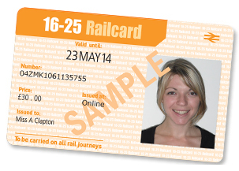
HOW MUCH?
TRAVEL
?
How much is a 16-25 Railcard?
£30 for 1 yr
£70 for 3 yrs
Studying in London? An 18+ Student Oyster card can
save you 30% on Bus, Tram & Travelcard prices

Slide 19

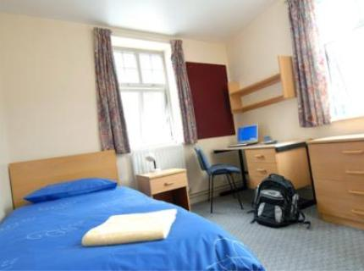
HOW MUCH?
ACCOMMODATION
?
What is the average weekly cost
of student accommodation?
Lowest?
£123.96
per week*
£114pw
Highest?
£431pw
*Approximate figures from Go Compare, based
on university owned accommodation & 30 week academic year

Slide 20


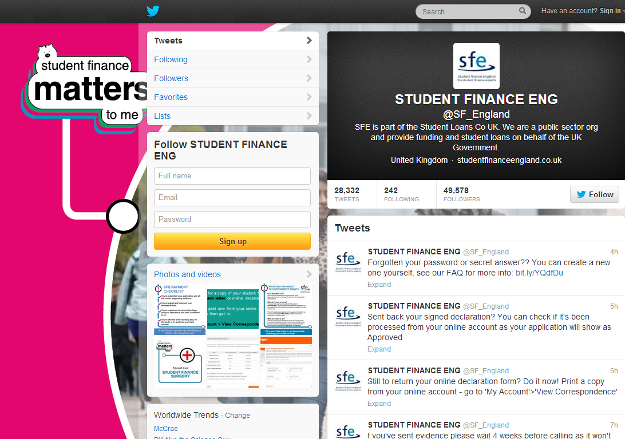
SOCIAL MEDIA
FOLLOW SFE FOR THE LATEST NEWS
www.facebook.com/SFEngland

Slide 21
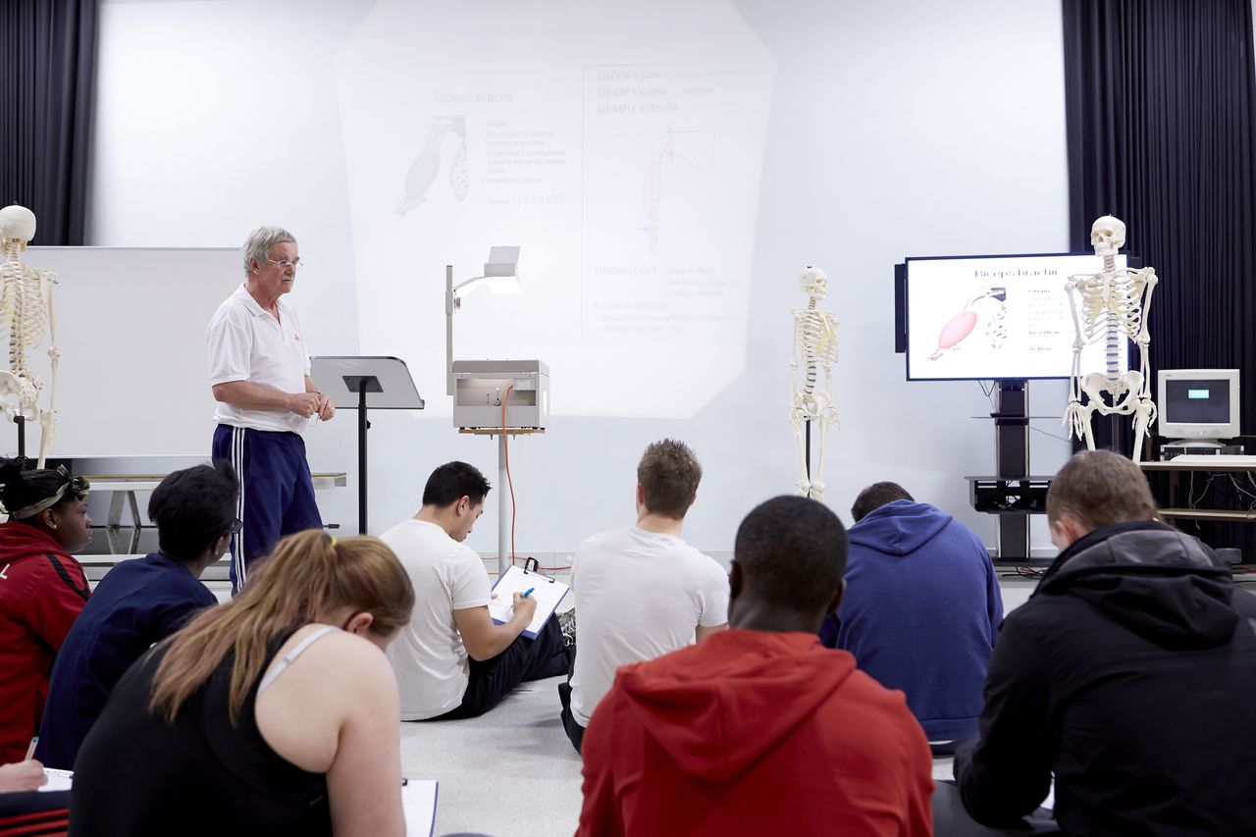
MANAGING YOUR MONEY
HINTS & TIPS TO CONSIDER
Before starting in higher education, think about the costs you are likely
to face and how to manage your money:
Plan a budget – and (try to) stick to it!
Ask questions and get any advice you need
Check out student bank accounts and NUS Extra cards
Try to avoid taking credit cards, store cards or pay day loans!!
If you need financial support and advice once you are at university
or college, staff there will be able to help

Slide 22

Any questions?
Steph Strange
Student Engagement & Recruitment Manager
Steph.strange@beds.ac.uk
www.beds.ac.uk
University of Bedfordshire Open Days:
// Saturday 9th February– Bedford & Luton
www.beds.ac.uk/open-days

Slide 23
Making your Choice
You should be making an aspirational choice and a “safe choice”
Do not choose your Firm and Insurance places with the same grade requirements
Unconditional offers
Go to track and make your choices

Slide 24
1st May 2019 - The date you need to make a decision on your firm and insurance choice if all your universities responded by the 31st March deadline. If UCAS do not receive your responses, they will decline offers on your behalf.

Slide 25
Accommodation Choices
Check accommodation opening of bookings and diary the date
Most popular halls of residence will get booked up quickly
Can you afford the site of choice? There will be variable costs depending on the facilities you want access to (e.g. your own bathroom)
Catered or self-catered accommodation
How far are the halls from your base of study?
What’s included in the price? (bills, Wifi, on site gym, University bus etc)
How many weeks are included in the price? Can you stay for example in the Easter holidays when you maybe preparing for end of year exams?
Do you want to go through a private landlord and not be in the halls of residence?

Slide 26
Extra
If students don’t get offers from any of their choices, they may be able to use Extra.
Applicants are eligible for Extra if:
    they have used all five choices
    all their choices were unsuccessful, cancelled, or they declined their offers
If using Extra:
    there is no option for an insurance choice
    the universities have 21 days to respond
    an applicant’s existing Apply information is used
Extra is available between February and July
.
Notes:
An Extra toolkit to help advisers is available at: www.ucas.com/advisers/guides-and-resources/extra-toolkit

Slide 27
Confirmation
Exam results are published – most are passed electronically to universities.
Admissions staff check if the applicant has met the conditions of the offer.
If the applicant does not meet the conditions of their offer (firm and insurance) and their place is not confirmed they are entered into Clearing.

Slide 28
Adjustment
Each year, some applicants pass their exams with better results than expected.
This may mean some will have not only met the conditions of their firm choice, but will have exceeded them.
The Adjustment process is for these applicants – it provides an opportunity for them to reconsider where and what to study.

Slide 29
What do I need to do now?
Student Finance Application- late Feb/early March
Accommodation application
Bursary Application
No-one will be chasing you! There are no movements on deadlines.

Slide 30
Notice
Missed coursework deadline
Did not attend today’s lesson, needs to access Firefly for lesson
Feedback not followed in work
Did not attend intervention arranged
Attendance concern in registration
Poor work ethic in supervised study
Folders/resources not bought to lesson
Missed homework / incomplete homework
Poor attitude to learning in lesson – not partaking
(Excellent classwork, Excellent homework, Good Ethical Contribution, Phone call praise, Positive Attitude)

Slide 31


