Slide 1





Introduction to Higher Education
Steph Strange – Student Engagement & Recruitment Manager

Slide 2


Going to University…
University will…
// Be a new & different experience
// Give you new skills & independence
// Make you more employable
// Boost your confidence
// Sculpt your future
// Broaden your horizons
Make sure you:
// Do your research & consider all your options
// Study something you are interested in
// Enjoy it!

Slide 3

Good reasons to go…
// Learn new skills – not just academic!
// Meet new people
// Live independently
// Live somewhere new
// Grow in confidence
// University can make you more employable
// Earn more – more about the £s later!
// It’s an investment in your future

Slide 4
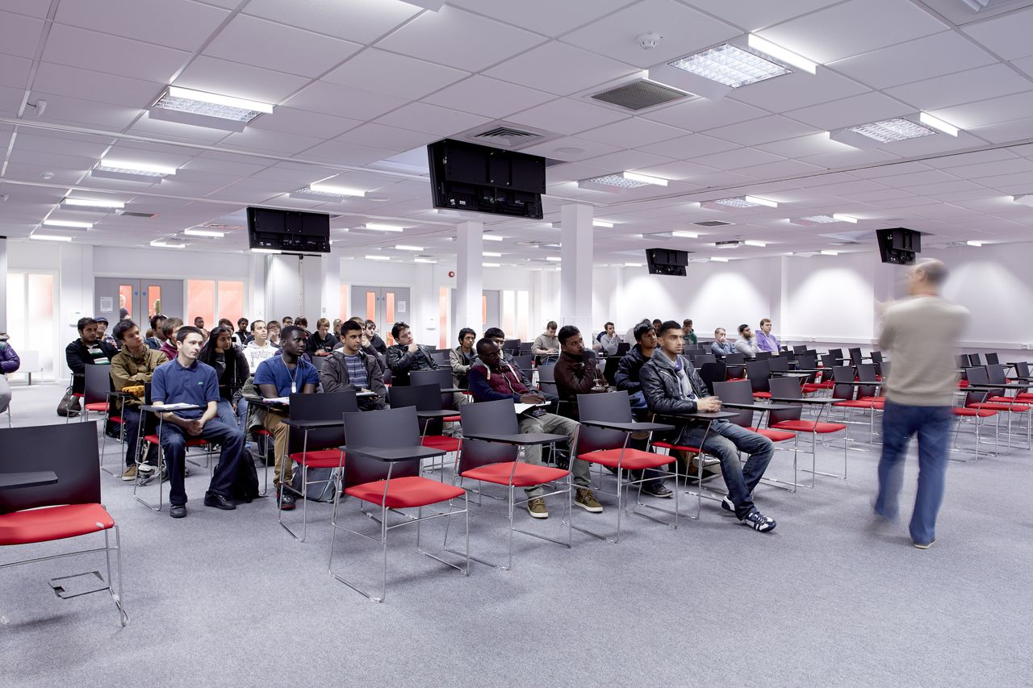
How to decide…
// Talk to tutors / parents / siblings
// Do you know anyone that has already been to uni?
// Speak to a Careers Advisor
// Visit universities! Experience them for yourself!
// Go to Open Days
// Try the subject out – Taster Days
// Attend UCAS Fairs
// Send for prospectuses
MAKE UP YOUR OWN MIND!

Slide 5

Where to study…
Think about the following factors…
// Where is the institution - close to home?
// What are the transport links like?
// What courses are on offer?
// How are the studies organised?
// How are you assessed? Exams vs coursework?
// How many students are there?
// How good are the study facilities?
// What is the leisure and social life like?
// How much does it cost to live in halls of residence, or in private accommodation?

Slide 6

Qualifications available
Two years
// Foundation Degrees (FdA/FdSc)
// Higher National Diplomas (HND)
Three years
// Degree courses (BA/BSc)
Four years
// Courses with Foundation Year
// Sandwich Degrees (placement/year abroad)
Five years +
// Medicine, Veterinary, Architect etc

Slide 7


UCAS…
UCAS (Universities and Colleges Admissions Service) is a central
organisation that processes applications on behalf of universities
and colleges
// The whole application process
is done online via www.ucas.com
// Applicants track their progress
with a user ID and password at anytime, anywhere
// Every course (Over 37,000 courses at over 390 institutions listed on the UCAS website)
// You will need to write a personal statement as part of your application

Slide 8
Choosing your course
There are over 37,000 different courses available within the UK from over 390 providers
// What do you currently enjoy studying/doing…
// Talk to your subject tutors and advisers at schools
// Load yourself up with prospectuses
// Try out your subject – taster days
// Think about what career your course might lead you to do…
// Make sure you’re interested in it!
// RESEARCH!

Slide 9
The UCAS calendar
Mid June Register with APPLY, start application
Mid September First applications can be submitted
Mid October Deadline for medicine, dentistry and veterinary science applications, and all applications to Oxford and Cambridge
Mid January Standard UCAS deadline
Mid March Start of UCAS Extra
August Results Day
Clearing lists released

Slide 10


The UCAS website…

Slide 11

Choosing your course

Slide 12
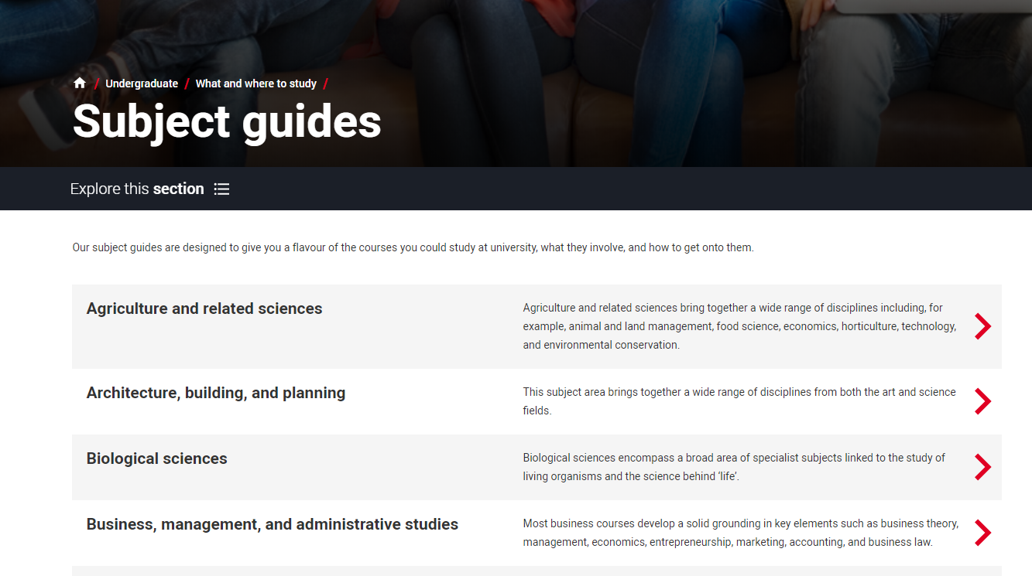
Choosing your course

Slide 13
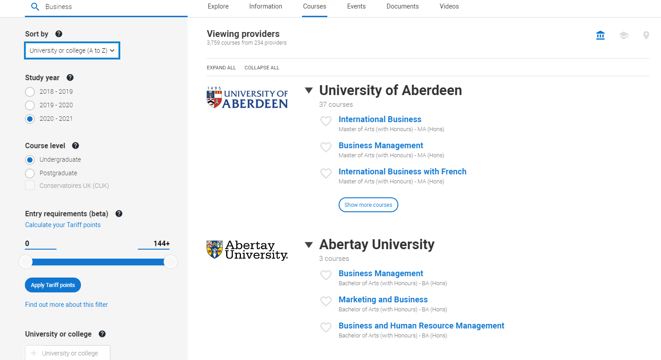
Choosing your course

Slide 14
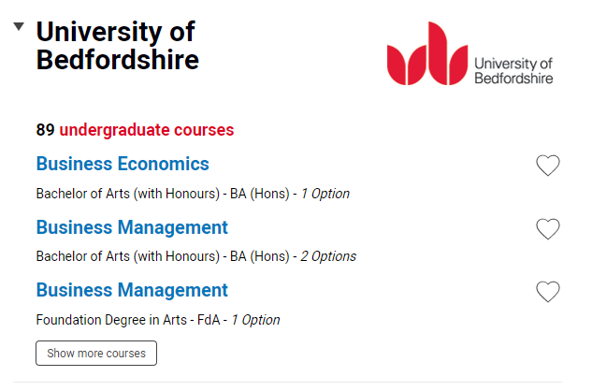
Choosing your course

Slide 15
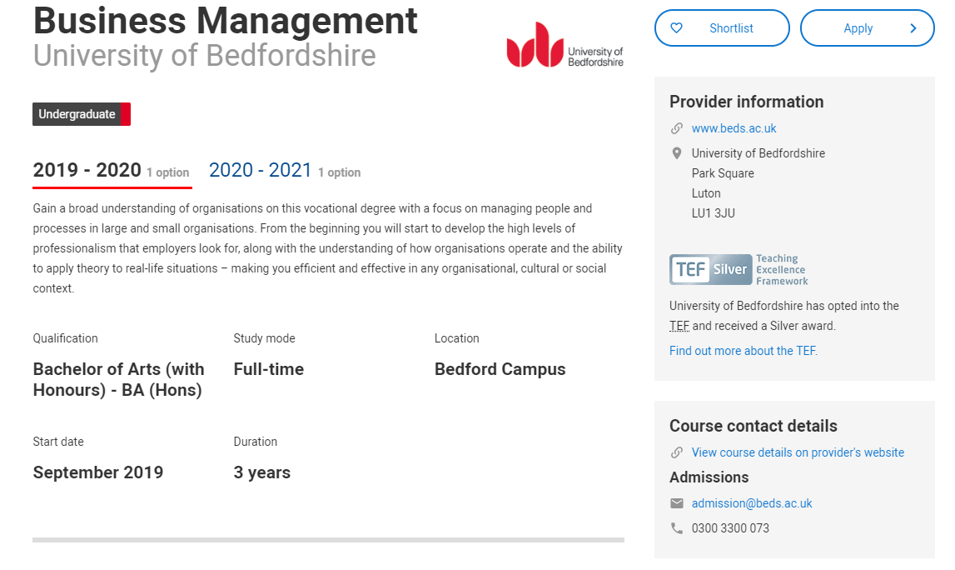
Choosing your course

Slide 16
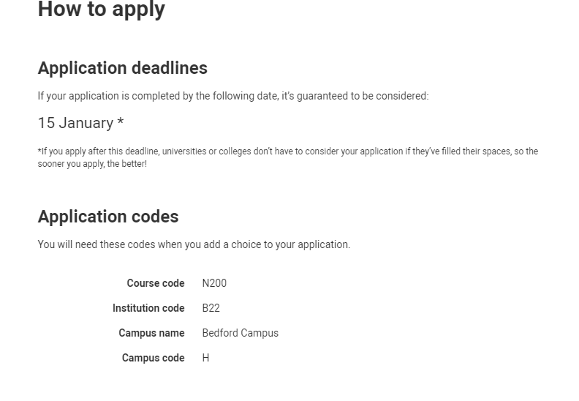
Choosing your course

Slide 17
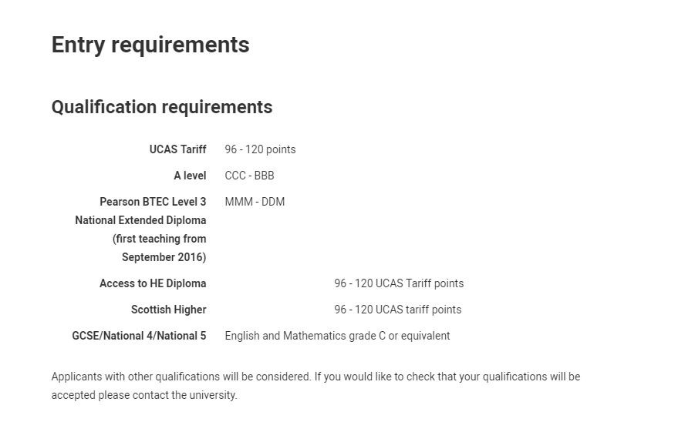
Choosing your course

Slide 18
Starting your application
// Make your application online using UCAS Apply www.ucas.com/apply
// You register using a ‘buzzword’ from your school/college
// You can apply to up to five choices (four if applying for medicine, dentistry or veterinary science)
The cost is £13 for one choice, £24 for up to five choices

Slide 19


Applying to University

Slide 20

What should I cover?
// Your reasons for choosing the course
// Show why you would be suitable for the course – relevant research, skills and experience
// Capability for higher level study – independence, motivation, academic ability…
// Why you want to go to university?
// Career aspirations, and why you would be suited to your chosen profession
// Details of jobs, placements, work experience or voluntary work, particularly if its relevant to your chosen course(s)_
// Other interests, abilities and achievements – show that you are a ‘well-rounded’ person

Slide 21

Student’s Union…
A Student Union is more than just a bar.
They are charitable organisations that you will be a member of as a student.
Their aim is to help you settle in, enjoy yourself and stay safe and happy
// Freshers’ Week
// Social Events
// Clubs and Societies
// Support with contracts and legal issues
// Help you to find accommodation
// Help and advise you with any other problems
// Provide work opportunities

Slide 22


Accommodation…
// Live at home
// University Halls of Residence
// Private Rented Accommodation
// Campus or city based?
// En suite or shared?
// City, Town or Rural?

Slide 23

Invest in your future…
Tuition Fees
// Universities and Colleges can charge up to £9,250 per year for a degree course… but this does not have to be paid up front.
// Tuition fee costs are covered by a loan which is paid directly to the university – you will only start to pay this back once you are earning over £25,000 per year
// It’s important to remember the benefits we talked about at the start – and the earning power and career mobility of graduates

Slide 24
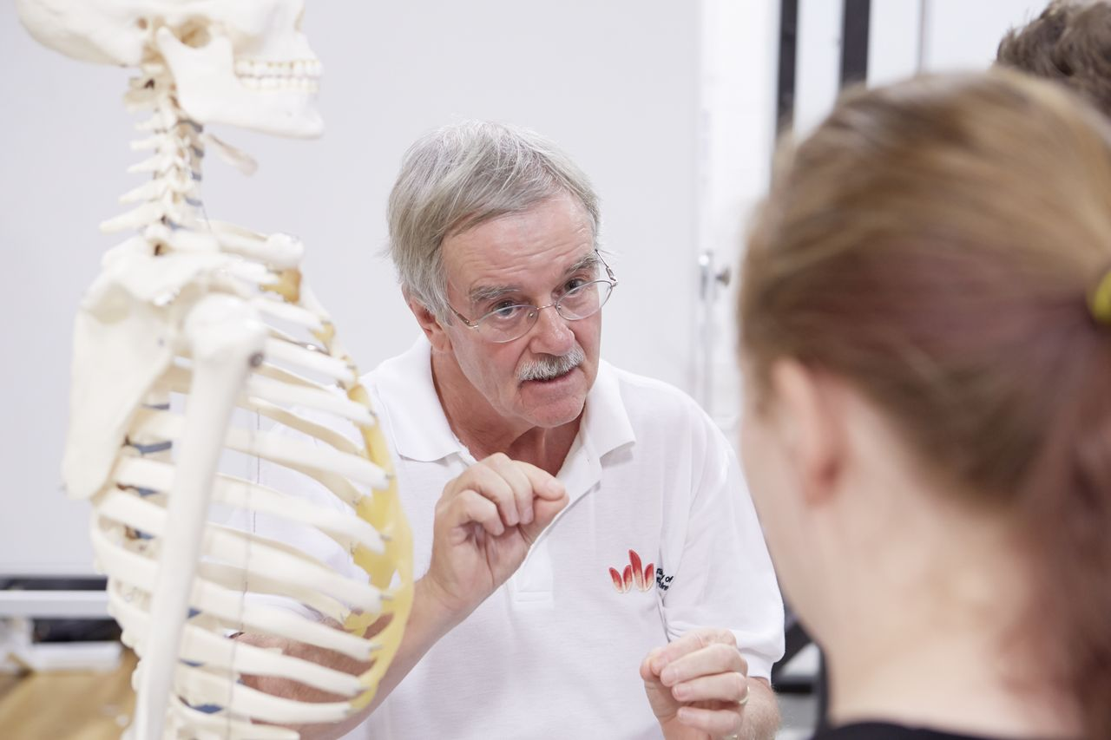
Cost of living
Maintenance Loans
// Loans – are means tested and again have to be paid back
// There are other forms of support to cover areas like disability support, childcare etc.
Scholarships and Bursaries
// All universities charging the maximum amount of tuition fee have to offer bursaries of some kind.
// The criteria is different for each of them.
// Keep an eye on your university’s website.

Slide 25

University of Bedfordshire
Scholarships/ Bursaries
// £1500 Bursary – all full time undergraduate students
// £2400 Scholarship for students achieving 112+ UCAS points in their Level 3 studies
// Sports Scholarships
// Foundation Year Bursary - £500
// £1500 Bursary – ALL full time undergraduate students
// £2400 Scholarship for students achieving 112+ UCAS points in their Level 3 studies
// Sports Scholarships
// Courses with Foundation Bursary - £2000 – for duration of 4 year programme

Slide 26

Next Steps…
// Take time to research ALL of your career options beyond Year 13
// Think about your interests, skills and what you enjoy.
// Seek advice…Careers Advisor, Tutors, Parents…
// How can you make yourself standout…
Extra Curricular activities
Work Experience
Responsibilities & other activities
// Develop your study & research skills.
// Work on time management, organisation & working independently
RESEARCH RESEARCH RESEARCH!
// Make an informed choice about your future

Slide 27

Finding out more…
// UCAS – all about applying & a good place to start: www.ucas.com
// Student Finance England – find out about funding your studies: www.gov.uk/student-finance
// Student room – independent advice: www.thestudentroom.co.uk
// UNISTATS – compare courses: www.unistats.direct.gov.uk

Slide 28
Money Matters…
// Universities and Colleges can charge up to £9,250 per year for a degree course… BUT this does not have to be paid up front.
// Tuition fee costs are covered by a loan which is paid directly to the university
// Help with your living costs, such as rent, food, bills etc. is also provided in the form of a Maintenance Loan…the amount you get depends on where you chooselive & study & household income.
// These loans are only repayable once you are earning more than £25,000 per year
// See www.gov.uk/student-finance for more information

Slide 29
Money Matters…
Average Graduate Starting Salary | Average Non-Graduate Starting Salary
£26,500 | £17,000
// Salary depends on what you study, the kind of work you want and the location
// Over their working life, the average graduate will earn around £100,000 more than a person who finishes their education at Level 3
// Consider investing in your future.

Slide 30

Any questions?
Steph Strange
Student Engagement & Recruitment Manager
study@beds.ac.uk
www.beds.ac.uk
University of Bedfordshire Open Days:
Wednesday 3rd July 2019
www.beds.ac.uk/open-days

Slide 31
Key Dates
Date (s) | What is happening?
Beginning of Year 12 | Registered with Unifrog
20th June | UOB Higher Education Conference
8th July | Future Pathways Day
Before the Summer Holidays | 1st draft of personal statement to tutors
15th August | Results Day (BTEC/EPQ)
22nd August | Results Day (GCSE resits)
4th September | Year 13 lessons begin
September | Teachers writing Subject References
15th October 10th (school) | Applications for Oxford, Cambridge or most courses in medicine, dentistry and veterinary medicine/science (UCAS)
15th November | School deadline for all other UCAS applications
15th January 2020 | UCAS deadline

Slide 32
External & Internal Exams
External Exam results
  BTEC courses
  EPQ
  Will need to be declared on the UCAS application form
Internal Exam Results
  Tracking home to you before the end of this half term

Slide 33
UCAS References
Written by the tutor
Each department will write a subject reference - subject specific skills
  This includes a predicted grade
2 week turn around
Final checks and meeting

Slide 34

Things to do over the Summer Holidays…
Continue completing UCAS application
Open Days/Visits to Universities
2nd draft of Personal Statement
Volunteering/Work Experience opportunities
USEFUL WEBSITES
https://www.unifrog.org
https://www.ucas.com
https://www.allaboutschoolleavers.co.uk/

