Slide 1

What Next?
What can I do with my A-levels?

Slide 2














Option 1: University
Option 2: School Leaver Programme
Option 3: Higher Apprenticeship
Option 4: Gap Year

Slide 3
// Pursue your passion/vocation
// Career choice, opportunities and flexibility
// Earn more… by completing a HE course you’re likely to earn 47% more over your lifetime
// Independent living, learning & life skills.
// Make life-long friendships.
Two years
// Foundation Degrees (FdA/FdSc)
// Higher National Diplomas (HND)
Three years
// Degree courses (BA/BSc)
Four years
// Scottish Degree courses
// Sandwich Degrees (placement/year abroad)
Five years +
// Medicine, Veterinary, Architect etc
Why
University?

Slide 4
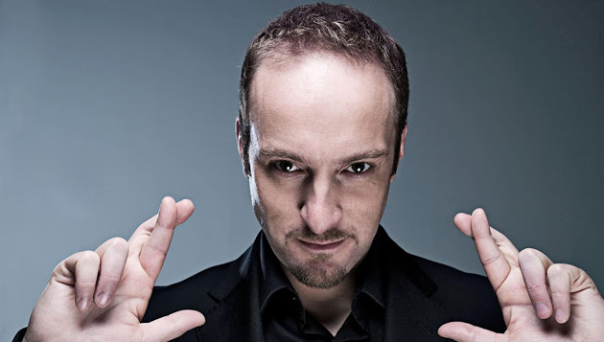
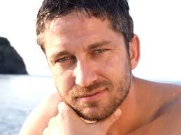
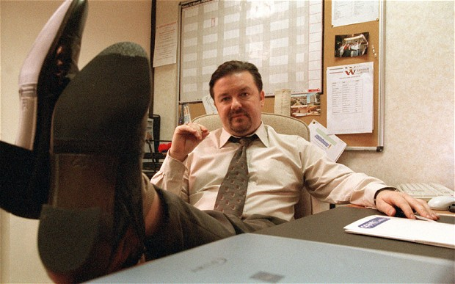

Celebs with degrees
Degree in Medicine from Glasgow University
Law and German from University of Bristol
Degree in Law from University Glasgow
Philosophy from UCL

Slide 5


Nuts and Bolts
of a
Personal Statement

Slide 6
What does it look like?
The opening...
Arresting & Original!
Main body...
Why are you going to be the best student of...?
The rest...
Activities and Positions
Conclusion...
Last impression!

Slide 7
Snippets…
My voluntary work at an elderly residential home 'Anjulita Court' was the setting that drew together philosophy and French. Whilst there, I met Irene, an elderly woman with dementia whose illness had reduced her to only being able to speak French; her childhood tongue. I remain the only person who can fully understand Irene, both emotionally and verbally. This community service greatly developed my fluency, whilst tutoring French on Saturdays has sustained my raw enjoyment of the French language. This experience puts me in the company of youngsters embarking on the first steps of their linguistic journey which astounds and amazes
me.
Gaining myself valuable experience from observing
Bedford Hospital departments I was able to access fields such as surgery, oncology and anaesthetics. Besides learning the typical procedures and responsibilities of medical professionals, I learnt of their vital roles in society as well as understanding how engineers
and scientists also contribute to the care of patients via their significant research and
development.
After several years of contributing my efforts to the Student Voice Council and Student Researchers, I have had the privilege of becoming Head Girl. Through this I was given numerous rewarding leadership roles which required a confident and pro-active attitude towards being a successful ambassador for the school. Aiming to promote independent leadership and senior student responsibilities, I devised a 'Student Leadership Workshop. The workshop strives towards implementing intimate mentoring, self-goal-setting and strategic planning into our school programmes. Through this development I gained greater leadership skills, confidence and professional recognition within my role.
I am an avid sportsman with Rugby as my sporting passion. Having played from the age of six, I have learnt some invaluable life lessons and transferable skills such as perseverance, determination, leadership and an insatiable desire to win and to succeed. I have captained all my school's teams as well as the Bedford Blues and have progressed into the Bedford Colts with whom I am competing at a local and national level. Being named player of the year for the past three seasons is immensely satisfying as it conveys the esteem in which I am held by my peers.

