Slide 1
6th Form Psychology
Objectives:
To help you understand the course content and answer some key questions.
To help inform your decision about A level choices in September
To set tasks which you will complete over the summer if you wish to study Psychology

Slide 2
Who will be teaching psychology?
Mr Turner and Mrs Smith will share the lessons in Year 12.
There will be four lessons with each teacher every fortnight.
Most lessons are likely to be in room 22.

Slide 3
Introduction to the study of behaviour
Starter:
This is a video I normally show to new students, it is from The Big Bang Theory show. It genuinely shows one psychological approach to explain how we learn – it is the basis of the behaviourist approach (learning theory). We will study this in some detail in Year 1.
https://www.youtube.com/watch?v=teLoNYvOf90

Slide 4
Which topics are studied?
Year 1
Year 2
Attachment
Memory
Social Influence
Approaches
Psychopathology
Biopsychology
Research Methods
Schizophrenia
Relationships
Forensic Psychology
Research Methods

Slide 5
For examples of the type of things we study you can look at the following video clips
Year 1
Year 2
Memory - Clive Wearing case study
https://www.youtube.com/watch?v=Vwigmktix2Y
Schizophrenia
https://www.youtube.com/watch?v=cbCtE5fEJ6Q

Slide 6
Which GCSE subjects are most relevant?
The answer is science and maths
Psychology is the study of human behaviour – in a scientific way – using scientific methodology. This is why it is found under science if you look it up in a university prospectus. You can therefore expect to be using scientific approaches and manipulating data.
Moreover, the reason why lots of A-level and degree-level courses ask for mathematics is not just because of the actual numerical work but because of the understanding needed for the design and interpretation of investigations and their findings.

Slide 7

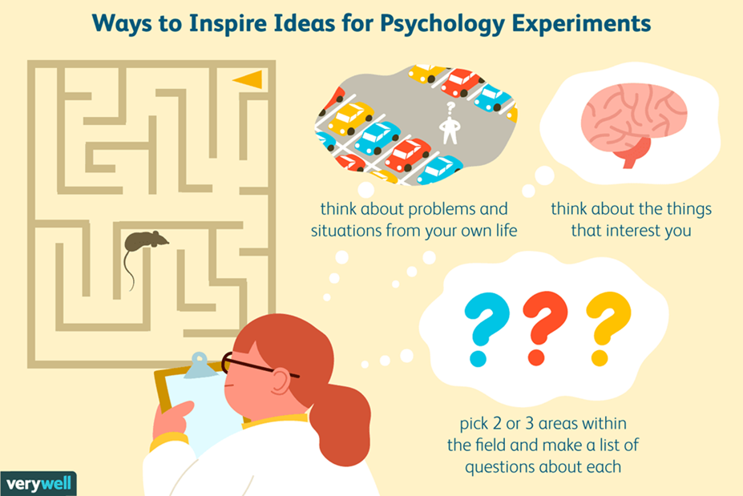
Where does the science and maths come in?
You need to become confident with the following scientific methods: field experiments, natural experiments, investigations, surveys, interviews, observations, case studies and questionnaires.

Slide 8


Where does the science and maths come in?
You need to become confident with manipulating and analysing data - e.g. is it qualitative or quantitative and is it reliable or valid.

Slide 9
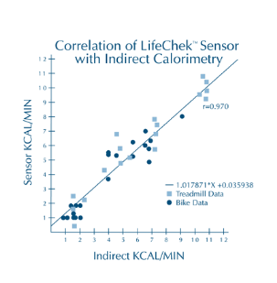
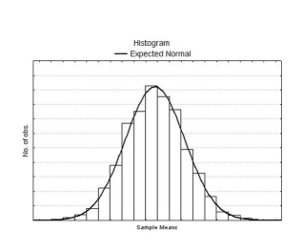
Where does the science and maths come in?
You need to become confident drawing and analysing graphs, bar charts, scattergrams and correlations

Slide 10
Some examples of Yr. 1 content
The following are examples of one topic which will be taught at the start of September – Attachment. These are some relevant video clips:
Strange situation research
https://www.youtube.com/watch?v=PnFKaaOSPmk
The case study of Genie
https://www.youtube.com/watch?v=VjZolHCrC8E
Bowlby’s monotropic theory
https://www.youtube.com/watch?v=nKMgJD-VDzc

Slide 11
Is there any coursework?
How will students be assessed?
There is no coursework
There are three exams at the end of the two years:
Paper 1 – 90 minutes
Paper 2 – 90 minutes
Paper 3 is based on Year 2 topics and lasts 2 hours
Here are some examples of past papers from AQA
https://www.aqa.org.uk/find-past-papers-and-mark-schemes

Slide 12
What is the Year 11 Transition task?
Where are the details?
The task can be found on Firefly if you look under Psychology A level
The task is a project where you need to find some data and then use it in a scientific way to answer a question.
You will need to follow the instructions very carefully
If you need some help you can email Mrs Smith or Mr Turner

Slide 13
What are my options if I have
A level Psychology?
Some examples of jobs/careers/further study
Clinical Psychologist:
This involves applying psychological theory to physical and mental health. Intervention can be in services such as: Adult Mental Health, Child and Adolescent services, Learning Disabilities, and Old Age Psychiatry. Clinical
psychologists also find themselves working in quite specific health areas such as Brain Injury or Eating Disorders. Work ranges from therapeutic interventions to practical rehabilitation.

Slide 14
Some examples of jobs/careers/further studies
Occupational Psychologist:
This focuses on improving productivity and well-being within a business setting. Intervention can include advising on recruitment procedures, psychometric testing, stress management, or health and safety. Work ranges from consultancy to practical training.

Slide 15
Some examples of jobs/careers/further studies
Health Psychologist:
This is an application of psychological theory to health issues. This includes areas such as the psychological effects of illness, for example
cancer diagnosis and treatment or health promotion such as smoking cessation or healthy eating information and support.

Slide 16
Some examples of jobs/careers/further studies
Forensic Psychologist:
This is most easily understood as the application of psychological theory and methods to aspects of crime. Interventions include working with the police, the courtroom, and prison settings. Work ranges from advisory roles to hands-on rehabilitation work.

Slide 17
Some examples of jobs/careers/further studies
Counselling Psychologist:
This involves therapeutic counselling, usually at the less severe end of the mental health spectrum. Clients may include those with psychological disturbance resulting in depression or anxiety, for example.

Slide 18
Some examples of jobs/careers/further studies
Research Psychologist:
Essentially, this is the application of psychological theory and research methodology to investigating a specific research question.
Teaching Psychology:
This involves the application of psychological theory and methods in working in the compulsory or post-compulsory (further/higher) education sector.

Slide 19
Other areas in which Psychology graduates are often employed include
Advertising
Armed Forces
Banking and Finance
Business Management
Diplomacy
Human Resources
Nursing
Pet Psychology
Police
Sales and Marketing
Social Work
Sports Psychology
Psychometric Testing
Psychotherapy
Statistical Analysis

Slide 20
Plenary
I hope you have a better idea about psychology A level now.
You should have a better understanding of the course.
You have the answers to some key questions.
I hope you are in a better position to make your choices
You should know what the transition task is and where to find the details and help

