Slide 1

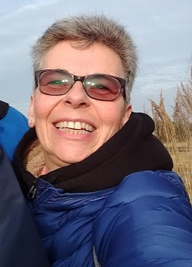
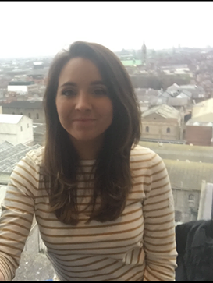
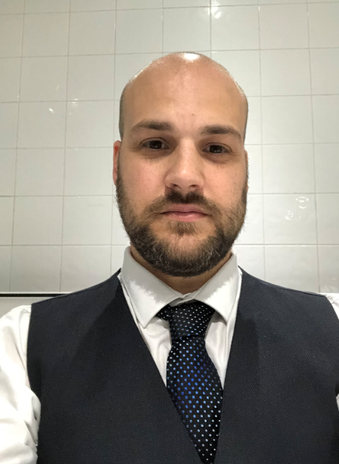
A level Biology
Meet the team
Miss Petersen
Assistant Head of Year
And Assistant Head of Biology
Mrs Bonham
Head of Biology
Mr Cropley
Head of KS3

Slide 2
Where can Biology take you?
Biology can lead to so many exciting and interesting careers….
Such as:
Marine Biologist
Pharmacologist
Research Scientist
Biochemical Engineer
Ecologist
Forensic Scientists
Doctor or nurse
Nutritionist

Slide 3
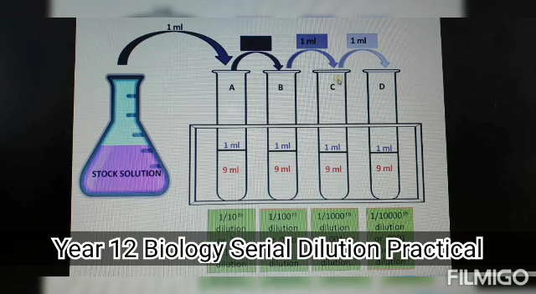
What to expect from the course..

Slide 4
A-Level biology
You should choose this subject because you enjoy it and have a passion for it!
You may also choose it as you want to continue studying it at a higher level / it is needed for you to go into a certain career.
Whatever the reason, you should enjoy the work and be prepared to work as a team in the learning process as well as learning to be an Independent learner.

Slide 5
What is expected of me?
You must gain at least a grade 6 at GCSE.
You must be committed to work hard.
Be prepared to hand in work on time and be prompt to lessons.
You need to be able to do work by yourself, ie research facts.
You need to be able to work as a team / small group work in the lab BUT also be able to do INDIVIDUAL lab work.
To take responsibility for your learning, if unsure seek help!!
Have a passion for the subject!!

Slide 6
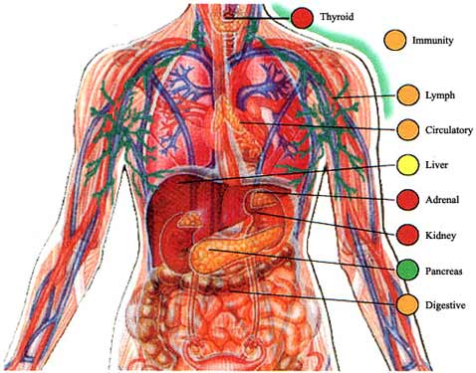
What is it all about?
Year 12
Biochemistry of molecules ( proteins, fats, carbohydrates), enzymes, Cell divisions, mitosis ,and meiosis, movement of substances in plants & animals.
DNA and gene codings and some classification.
You will NO LONGER have a practical examination as course work , but there are 6 practicals that YOU MUST complete and you can be tested upon these in your written exams.
IT IS VITAL that you DO NOT miss any of these sessions and you will need to catch up on these practicals should you be absent.

Slide 7
What is it all about?
Year 13
Ecology work, cycles & photosynthesis, muscles, nerves, the kidney, hormones in plants & animals.
Further work on DNA, genetics, statistical tests, respiration.
Again, 6 practicals that YOU MUST complete and you can be tested upon these in your written exams. (In total there are 12 assessed practicals over the 2 years)
IT IS VITAL that you DO NOT miss any of these sessions and you will need to catch up on these practicals should you be absent.

Slide 8
What examinations will you take?
At the end of yr 12 there will be AN INTERNAL exam. (this will not count towards your final grade)
At the end of yr 13 you will have 3 exams, each 2 hours long.

Slide 9
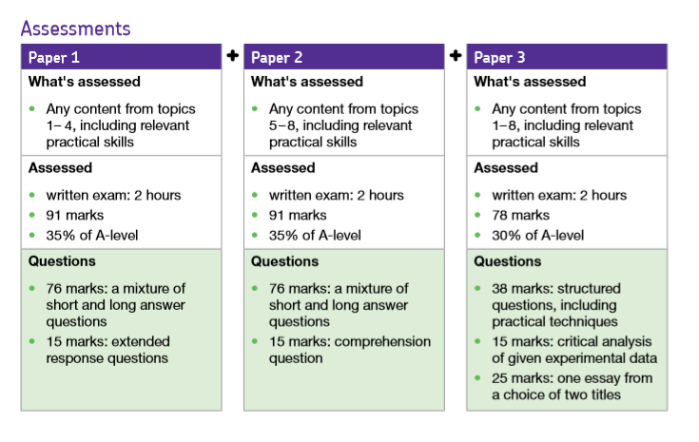
How are you assessed at A level?

Slide 10
What else is expected from me?
Lastly, if you are EVER unsure, please ask for help / advice.
DO NOT struggle along on your own!
You can come to the science dept ANY time…come into class and ask ..even if I am teaching…I may or may not be able to help you!!
Staff involved in teaching A level Biology;
Mrs Bonham HE2
Mr Cropley Lab 2
Miss Peterson Lab 6

