Slide 1
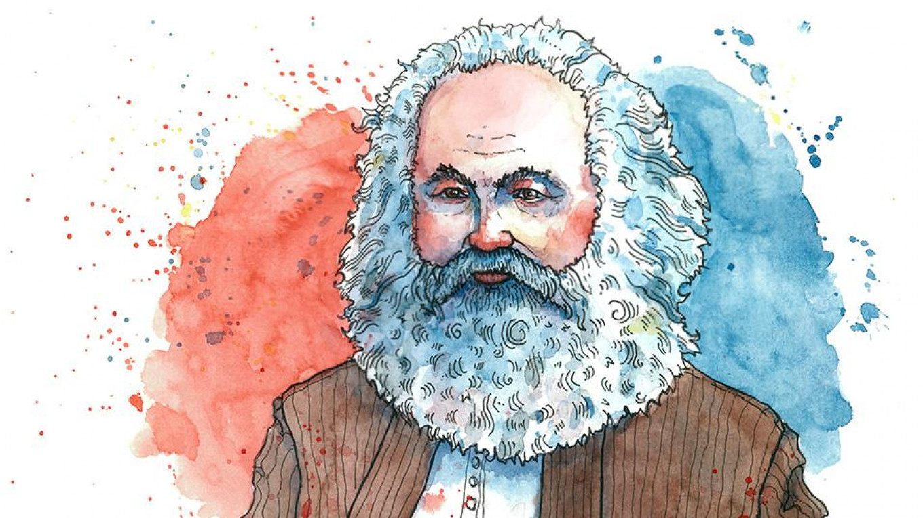



AQA Sociology
Sociology is the study of society and human behaviour.
How does our environment influences our behaviour?
How do inequalities in our society affect our
opportunities?
Units covered: Crime and deviance, family, education, beliefs in society, theory and methods

Slide 2


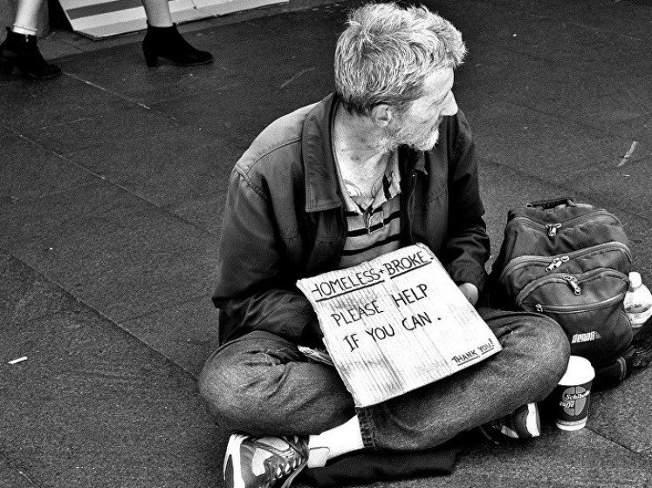
.
Why study sociology ?
How will I be assessed?
Are you interested in social issues or social justice?
Do you like discussions/debates?
Do you want to understand your own position in society or that of other people’s?
Do you want to learn the important skills of analysis and evaluation and essay writing valued at university?
Three external exams.
Each exam is = 33.3% of the overall grade.
A combination of essays and structured short answers.

Slide 3
Some of the many perspectives covered
Marxism and the significance of capitalism
Feminism and patriarchy
Functionalism
Postmodernism
Conservatism
Liberalism

Slide 4
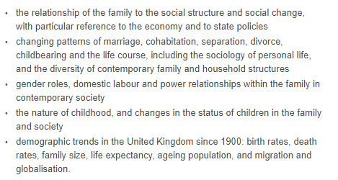
Families and Households

Slide 5
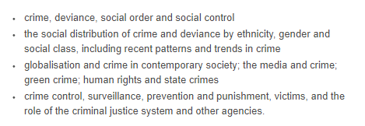
Crime and Deviance

Slide 6

Education

Slide 7

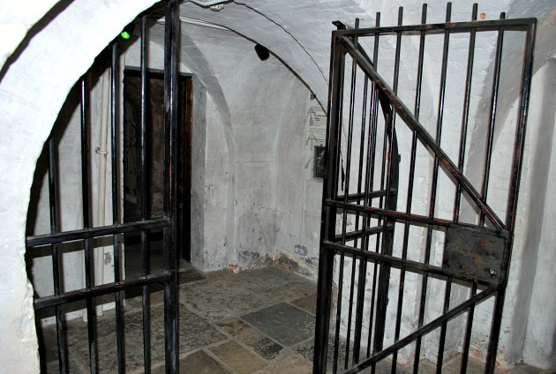
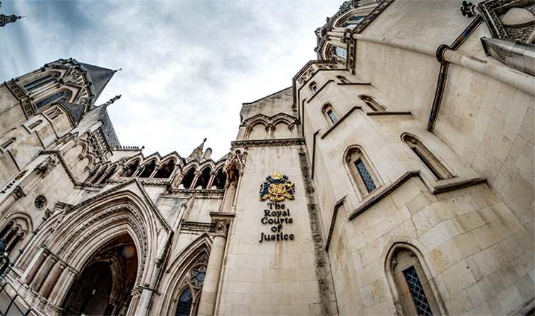
Trips and Career Opportunities
The Royal Courts of Justice
Revision workshops
Galleries of
Justice
museum
Do you hope to work with people? Sociology will support you in the following careers:
Police officer
Probation or prison officer
Social work and the caring professions
Research
Law - criminal /family
Nursing /midwifery
Teaching
Counselling
Housing Officer
Youth work
Local/central government

Slide 8
Please click on the link below to watch a video on what Sociology is all about.
Sociology Video

Slide 9

If you require more information please see…
Ms Bedeau
Room 23

