Slide 1

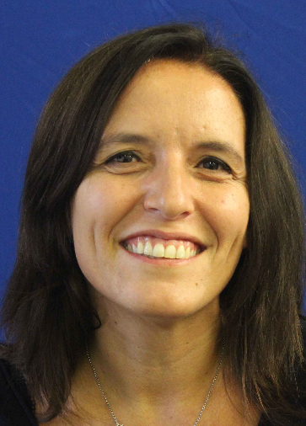

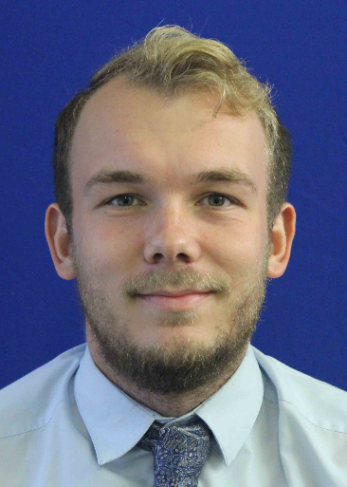
Welcome to A-level Chemistry!
The Chemistry Team!
Dr Ragni Mrs Maddams Mr Newman
Head of Head of
KS4 & 5 Chemistry
Play me!
A-level Chemistry teacher

Slide 2
Why Chemistry?
Chemistry can lead to so many exciting and interesting careers….
Such as:
Analytical Chemist
Environmental Chemist
Forensic Researcher
Play me!
Medicine - doctor
Lecturer
Chemical Engineer
Toxicologist
Geochemist

Slide 3
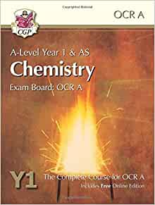
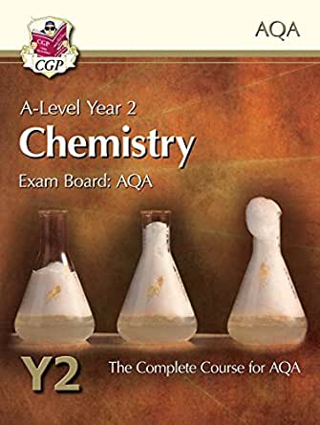
Textbook
Play me!
We’ll give you:
CPG Year 1 book in September of Y12
CPG Year 2 book in July of Y12
Exam board: AQA

Slide 4
ASSESSMENT (end of Y13)
Play me!
Paper 1
Inorganic chemistry + some Physical chemistry
35% 2 hours 105 marks
Paper 2
Organic chemistry + some Physical chemistry
35% 2 hours 105 marks
Paper 3
Practical skills, data handling and synopsis
30% 2 hours 90 marks

Slide 5
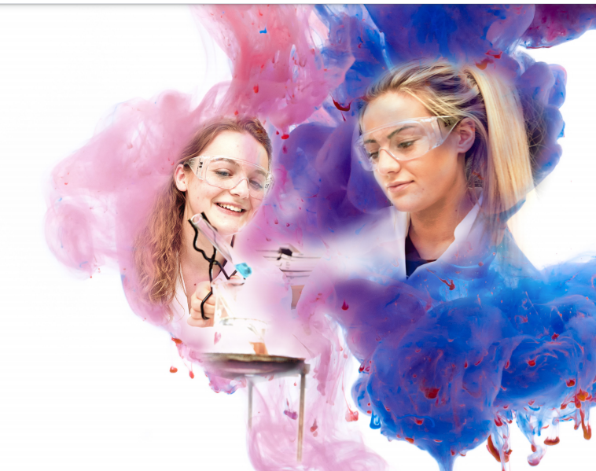
Just some of the practical’s you will do at A-level….
Practical Endorsement (Pass/not Pass) –
12 Required practicals – teacher assessed/moderated by AQA
Play me!
Make up a volumetric solution and carry out a simple acid-base titration
Measurement of an enthalpy change
Carry out simple test-tube reactions to identify cations and anions in aqueous solution
Investigation of how the rate of a reaction changes with temperature
Distillation of a product from a reaction

Slide 6
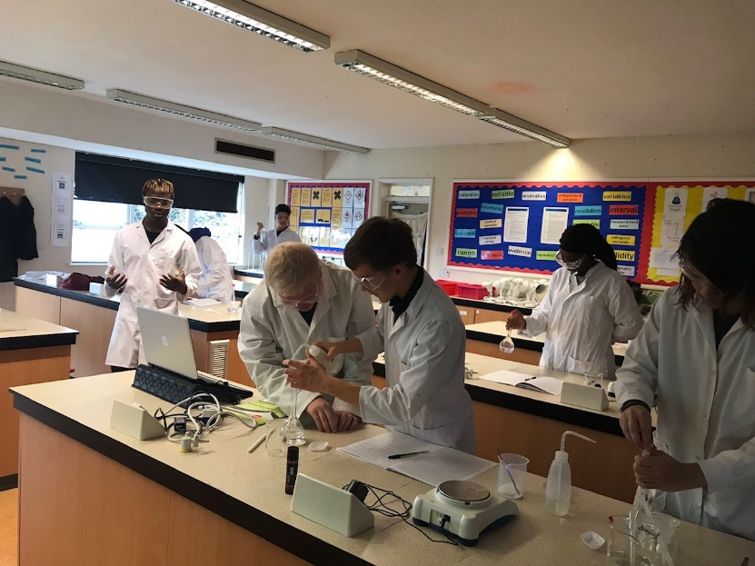
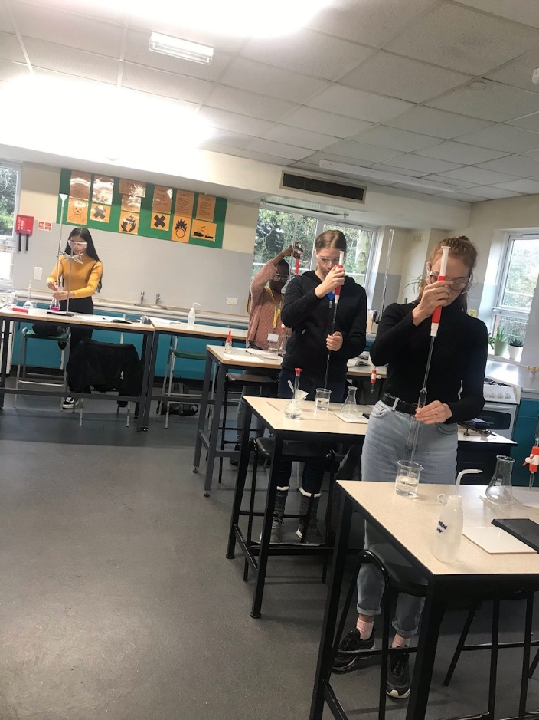
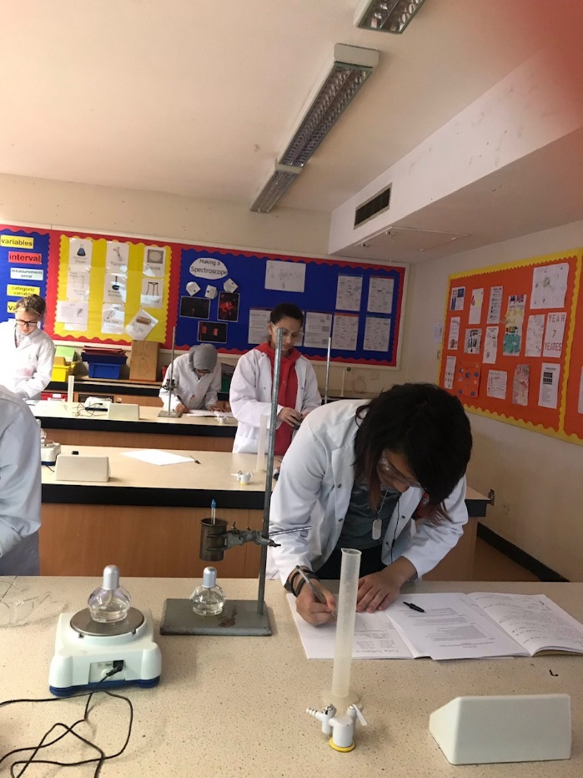
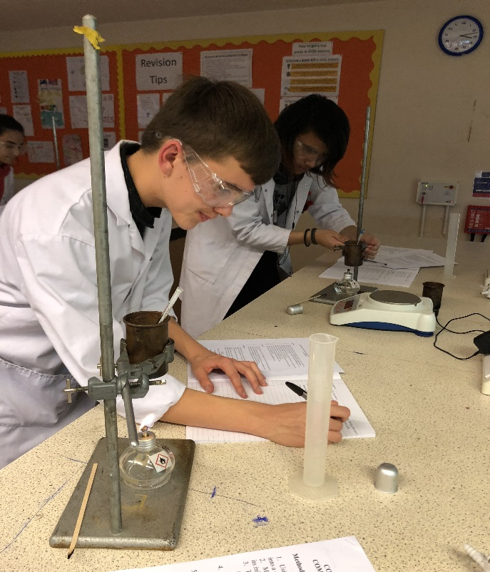
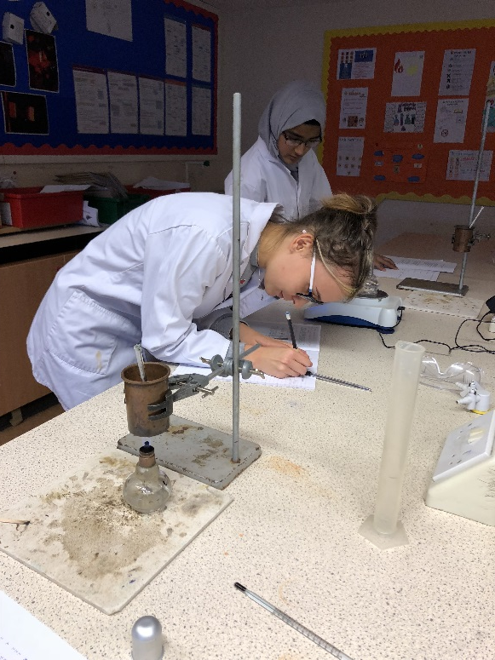
Some of our previous Chemists doing some of these practical’s:

Slide 7

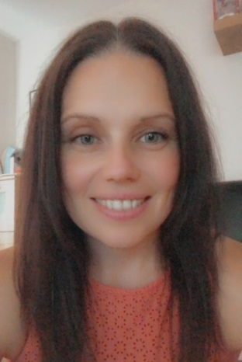

We hope you will consider A-level Chemistry as an option, any questions please speak to your science teacher or find of the Chemistry team.
The Chemistry Team!
Dr Ragni Mrs Maddams Mr Newman

