Slide 1
The Prayer Room
St Thomas More Secondary School

Slide 2
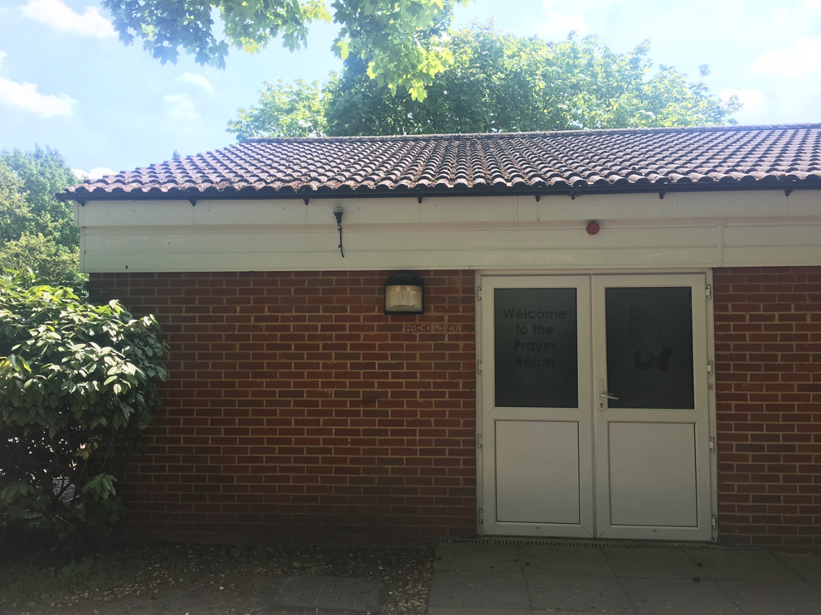
The Prayer Room is at the heart of our community. Its one of the first buildings you will see as you arrive. Its a friendly place. You can call in to say hello before school at break and lunch time. In the early weeks of term Mrs Burgess will have some activities for you to do and some older students to greet you.

Slide 3
Activities in the Prayer Room
During the week Monday – Thursday when you are not in lessons the Prayer Room is open. You will also visit the Prayer Room with your form teacher and through your RE lessons. As well as a place to meet and make friends it is also a place of prayer. You are welcome to join in with any of the activities for your year group below. Sometimes Mrs Burgess has to prepare readings, prayers and songs for celebrations. You might be invited to volunteer to join in!
Day | Activity
Monday | Lunchtime ICTHUS club Year 7&8 Bible based activities, games, quizzes, discussions. During the day: Special prayer time with Adoration of the Blessed Sacrament.
Tuesday | Lunchtime: Year 9-11 ASK group
Wednesday | 8.20am : Mass before school - All welcome and parents! Lunchtime: Worship group – All years
Thursday | 6th Form groups: Faith Ambassadors and B-Attitude group
Friday | Day off Mrs Burgess

Slide 4
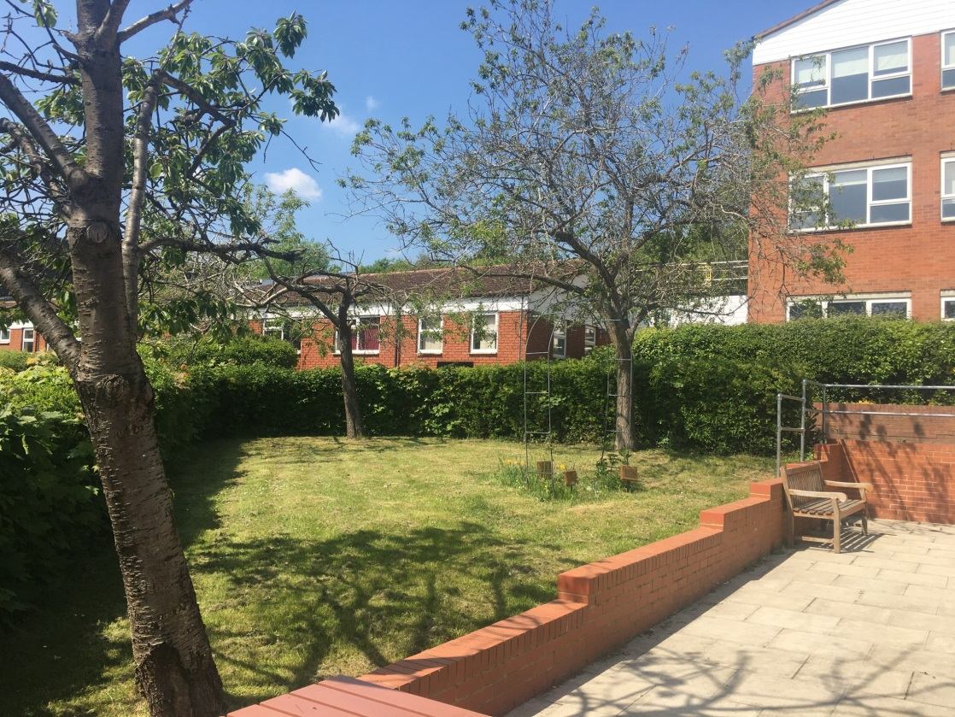
We also have a special garden space that we can use for prayer throughout the Year. Mrs Burgess will invite you to some prayer activities in the prayer garden.

Slide 5
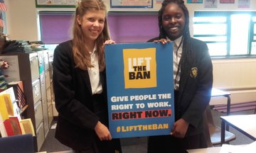
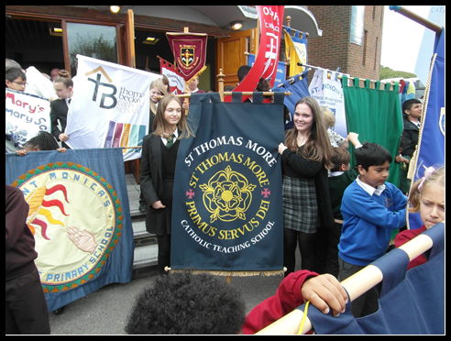
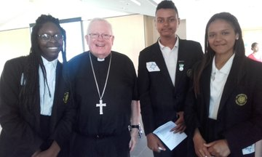
Trips and retreats
In the autumn term we like to take you on a retreat morning to the Church of St Philip and St James. We also have other trips through the year that you might get invited to such as the Diocesan Mass in Dunstable.

