Slide 1

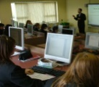
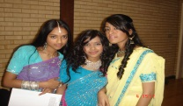
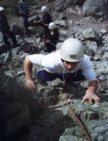
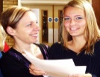
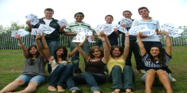
‘PRIMUS SERVUS DEI’
Our school is a community where we strive to:
Ensure that Faith is lived, taught and celebrated
Create exciting learning which enables all to experience fullness of life
Nurture the unique, prize the diverse and enjoy equality
Inspire, challenge and support one another as we journey together
Be a witness to the truth of Christ as we work with our wider community
Value and celebrate the achievements of all

Slide 2
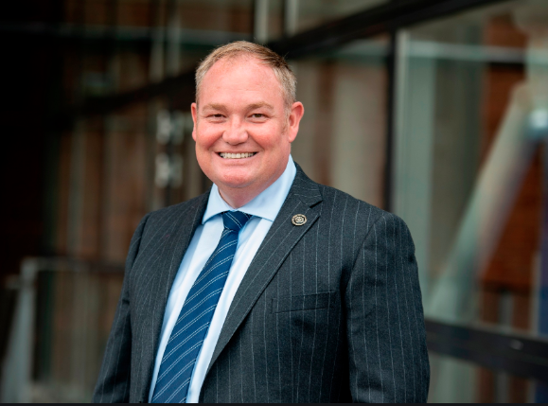
Mr Bonner
Head Teacher

Slide 3
The aim of this presentation
is to:
Introduce you to the school
Give you a little insight into Year 7 and our expectations for your time with us at St Thomas More
We are here to support and encourage our students at every stage and we look forward to getting to know you all individually.

Slide 4
Our expectations of our students are very high in terms of attendance, punctuality, uniform, presentation, behaviour and commitment to every class and to their coursework/homework.

Slide 5
The Curriculum
SUBJECTS STUDIED THROUGH KEY STAGE 3 (Yr7-9)
RE | GEOGRAPHY | ART
ENGLISH | DRAMA | FOOD
MATHS | MUSIC | FRENCH
SCIENCE | IT | DT
HISTORY | PE | PSHE

Slide 6
Tracking at
St Thomas More
Every term
Measured using the terms
    Emerging, Expected, Exceeding
Feedback on current work
Predicted outcomes
Behaviour, Effort, Home Work:1 / 2 / 3

Slide 7
Mr Kennard
Year 7 Progress Coordinator

Slide 8
Who is he?
It will be his responsibility to monitor student academic achievements and to implement strategies for improvement where necessary
He will also facilitate any additional support that Year 7 students may need
With an excellent team of tutors, our main focus is to ensure that the Year 7 students settle in quickly and start to achieve straight away

Slide 9
Mrs Claxton
Assistant Head Teacher
SENCo and Student Support

Slide 10
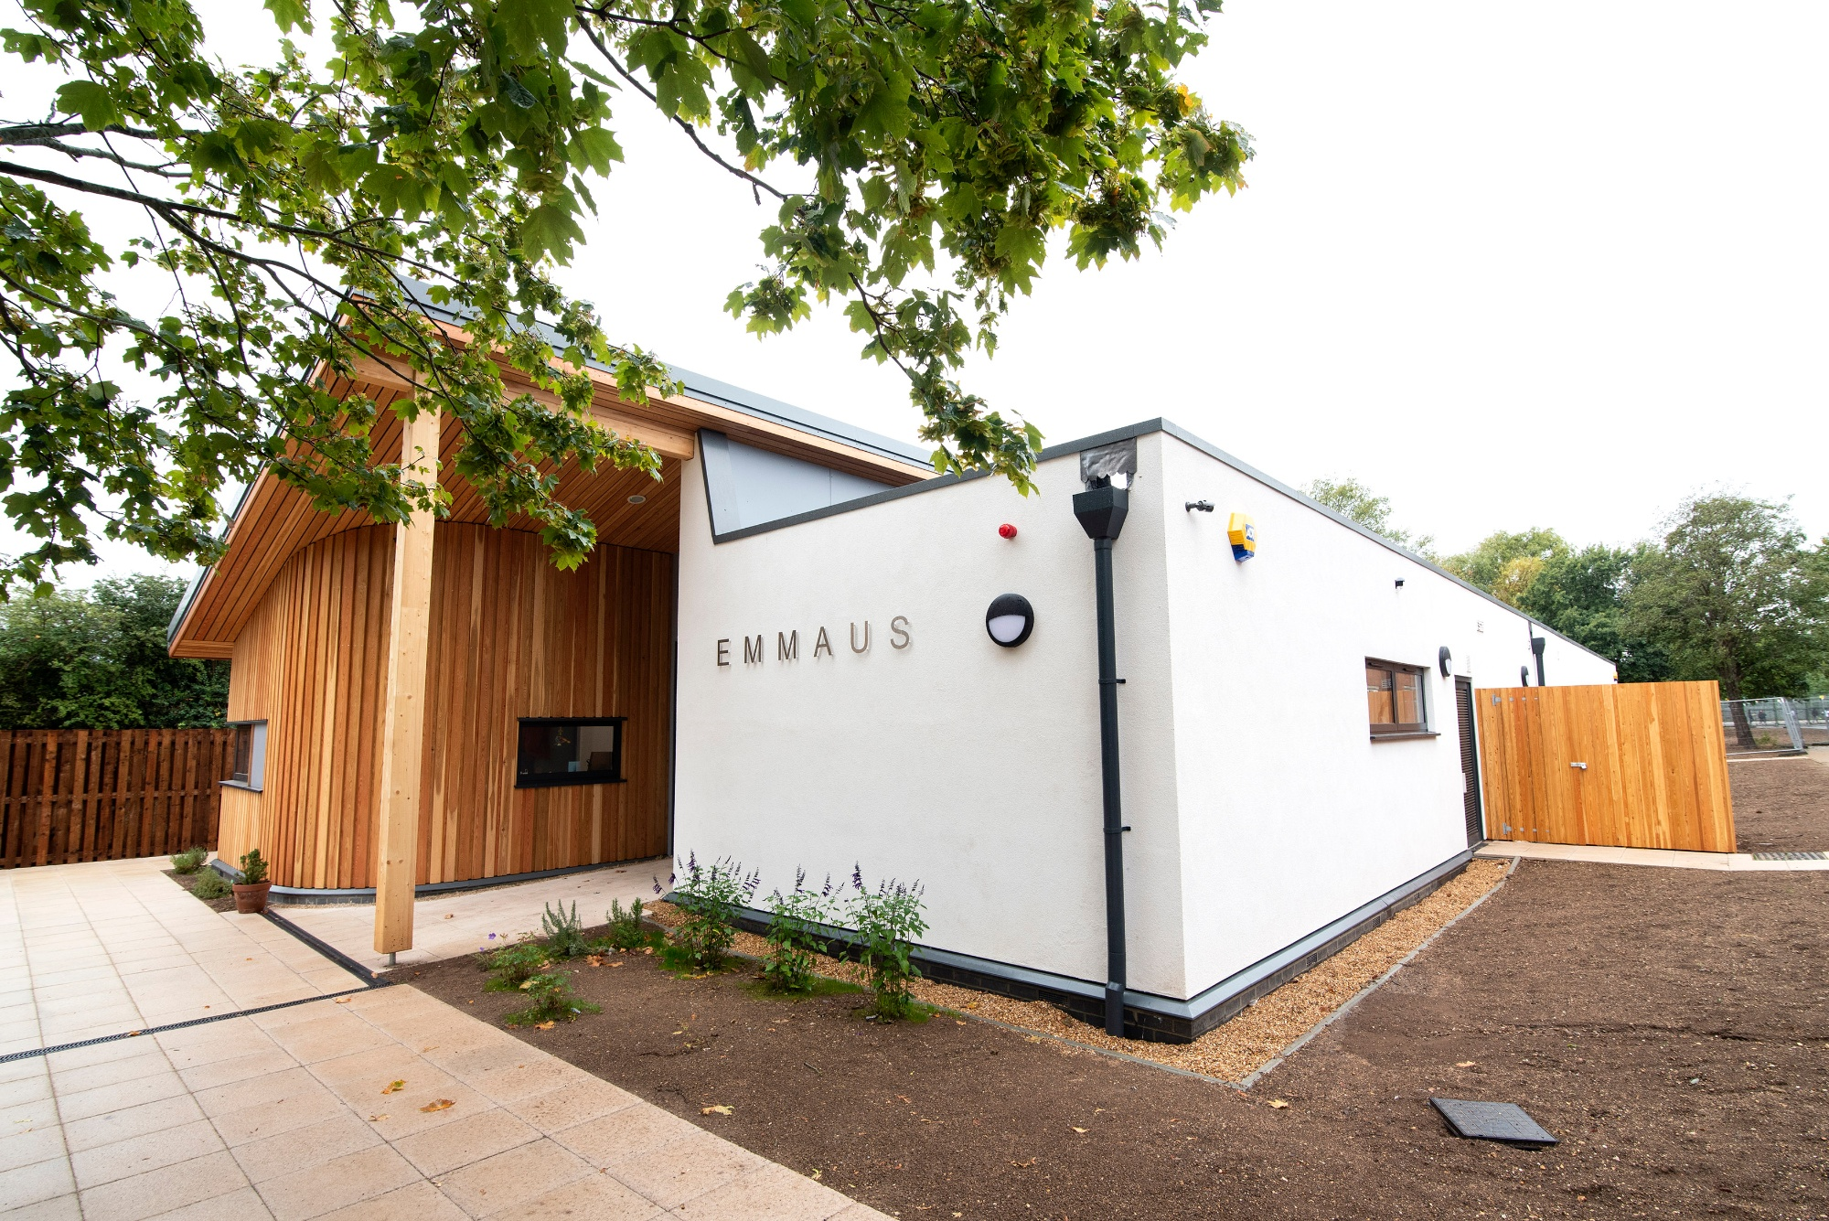
Emmaus

Slide 11
Emmaus
It is very important that students feel relaxed, enthused and ready to make a positive start at St Thomas More
At times however, students will need extra support within areas of their schooling
A vast network of support is available to all Year 7 students in addition to the Head of Year including form tutors, peer mentors and the Emmaus Team

Slide 12
Extra-curricular activities
Art, Drama, Music and sporting activities in which students compete both locally and county-wide. Students can aspire and work towards countless rewards including the opportunity to attend the Reward Trip at the end of the year. Students can also take pride in their school community by writing for the Year 7 Newspaper’ The Quill, and also by voicing their opinions in Student Voice.

Slide 13
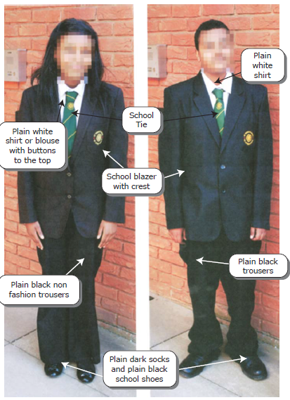
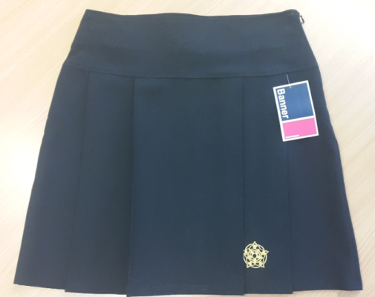
Pride in ourselves and our Community

Slide 14
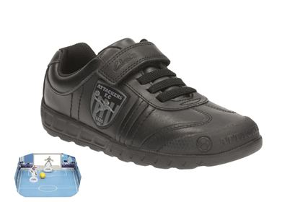
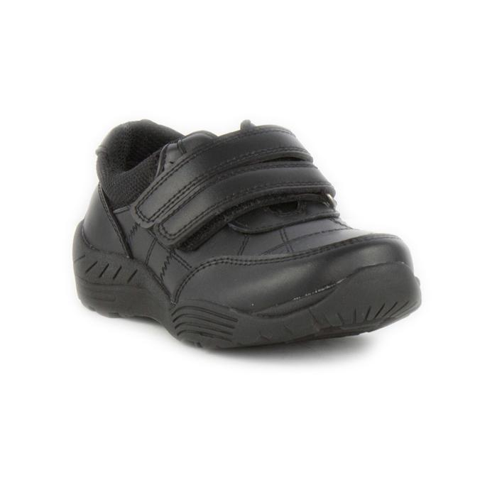
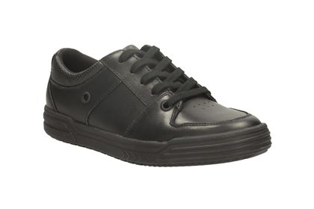
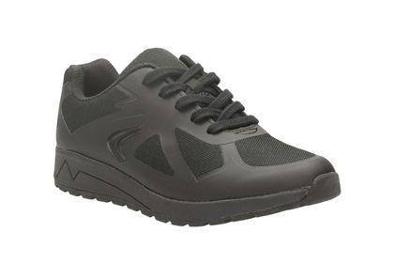
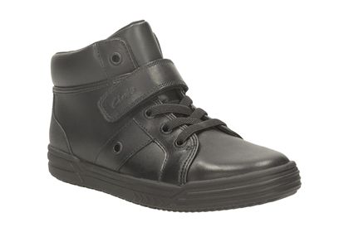
Not school shoes

Slide 15
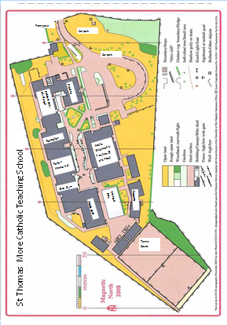
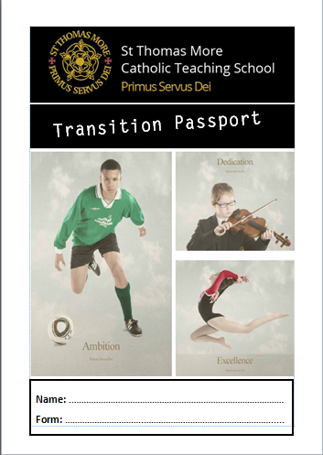
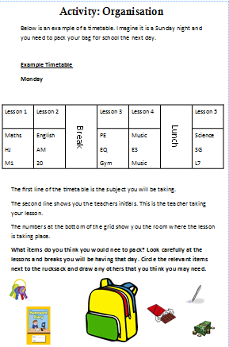
Transition Passport

Slide 16
Frequently asked questions

Slide 17
Where can I order the uniform?
www.yourschooluniform.com
Josens

Slide 18
How much money will my child need for food?
£2.50 full meal
Snacks range from £1.00
Water and drinks £0.80

Slide 19
What type of after school clubs are available?
It is the responsibility of the individual student to find out information for after school clubs
Information can be found in each department or in the Learning Resource Centre

Slide 20
Where will my child go at break time and lunch time?
There are many different areas that Year 7 can spend their break and lunch time
For the first 4 weeks Year 7 will be dismissed for lunch ten minutes earlier than the rest of the school
Students with packed lunches can eat their lunch in the canteen
They can spend time at the tennis courts, green areas, lunch time clubs, the LRC to list a few

Slide 21
Thank you

